Slide 1
Statewide Orthoimagery Program Coastal 2016 Eastern Piedmont 2017 Northern Piedmont & Mountains 2018
Statewide Mapping Advisory Committee
July 19, 2017

Slide 2
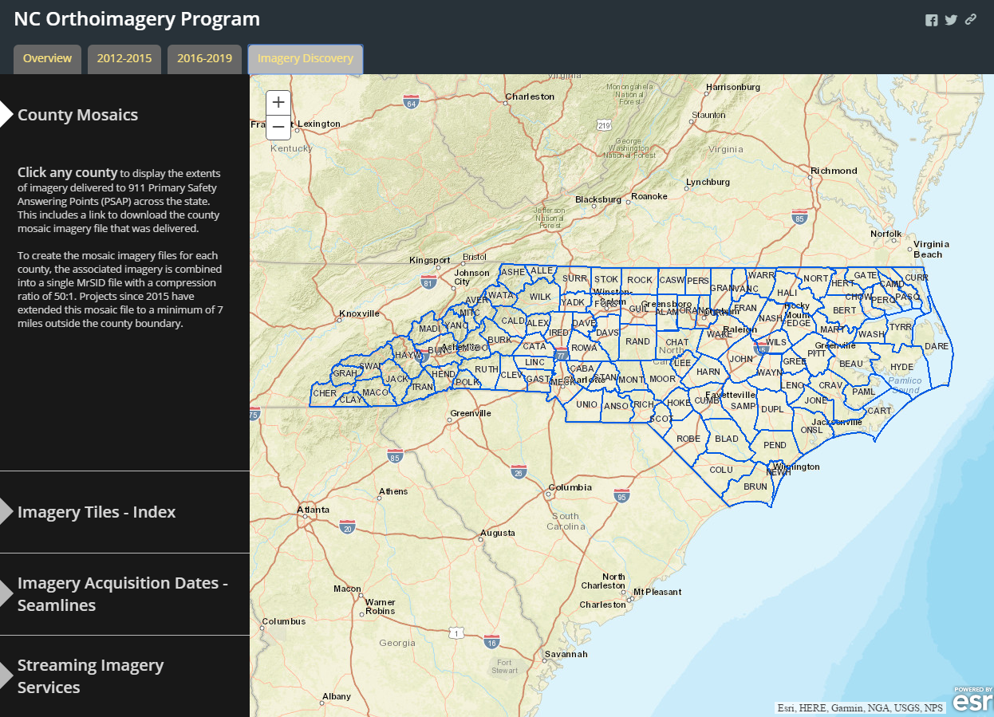
Project Website
https://nconemap.gov/Orthoimagery.aspx

Slide 3
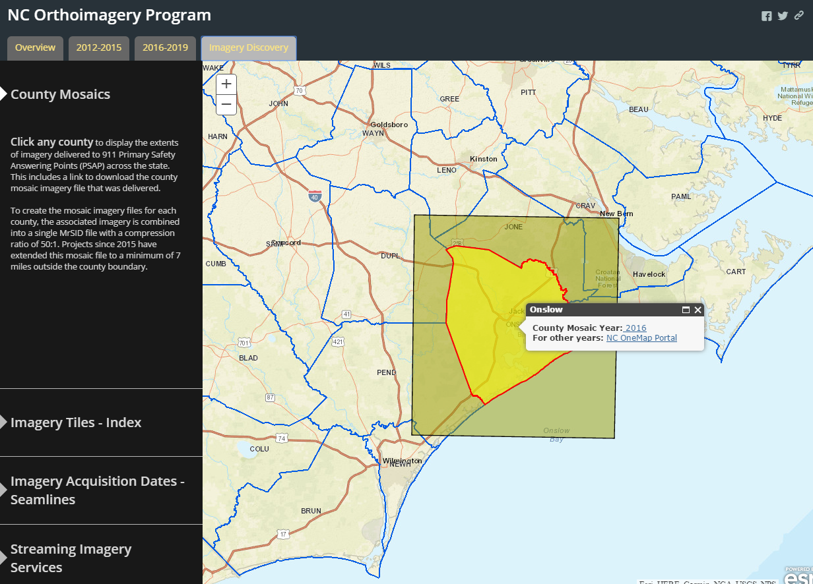
Project Website
https://nconemap.gov/Orthoimagery.aspx

Slide 4
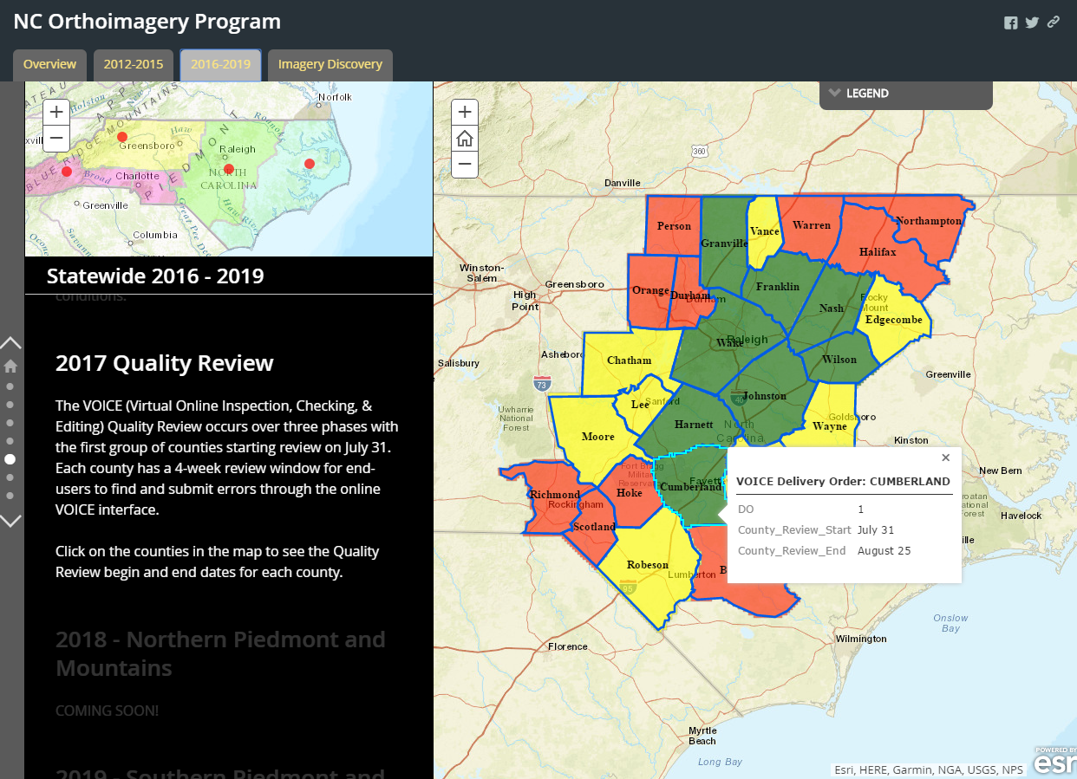
Quality Review Schedule
Notes:
Update

Slide 5
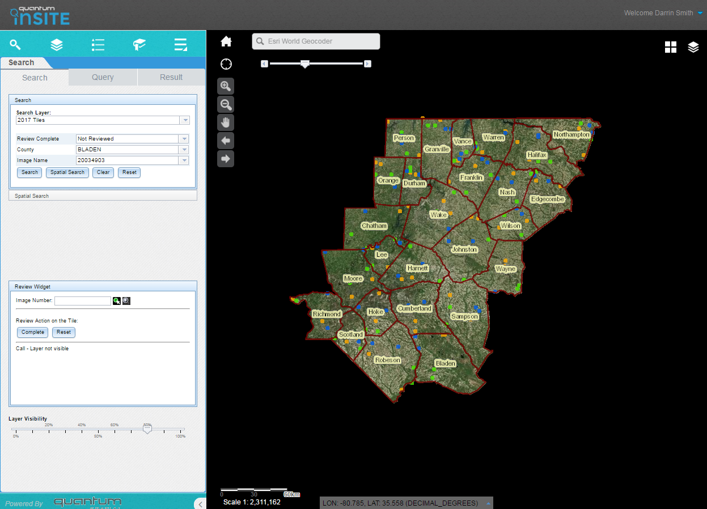
Quality Review Methodology

Slide 6
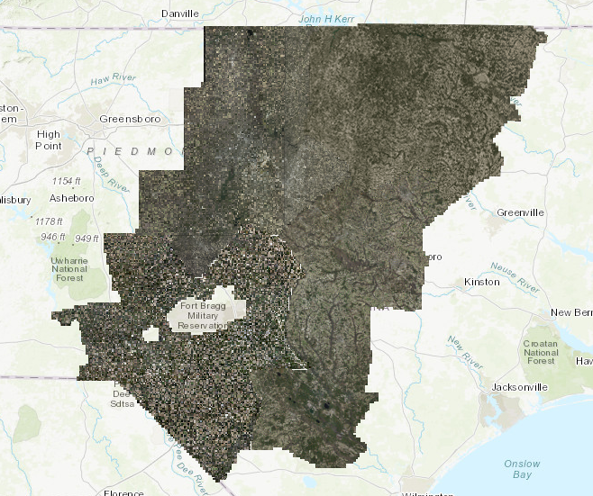
2017 NC Preliminary Orthoimagery

Slide 7
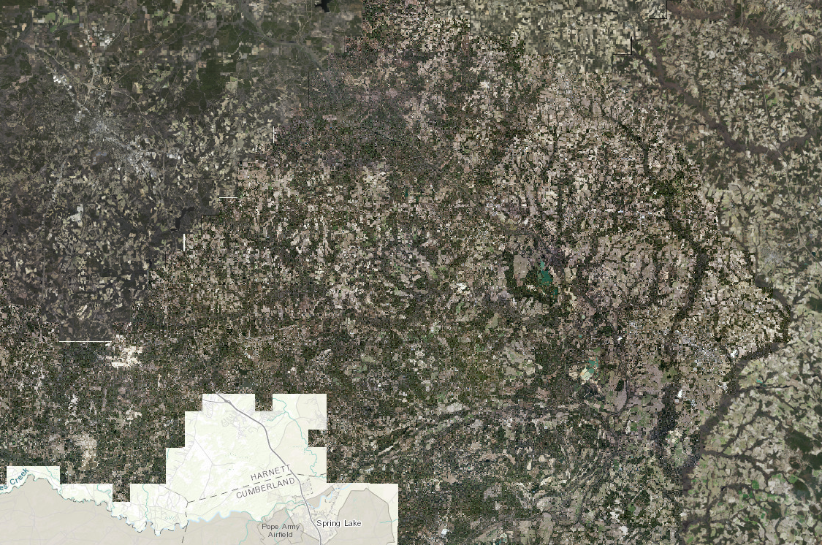
2017 NC Preliminary Orthoimagery

Slide 8
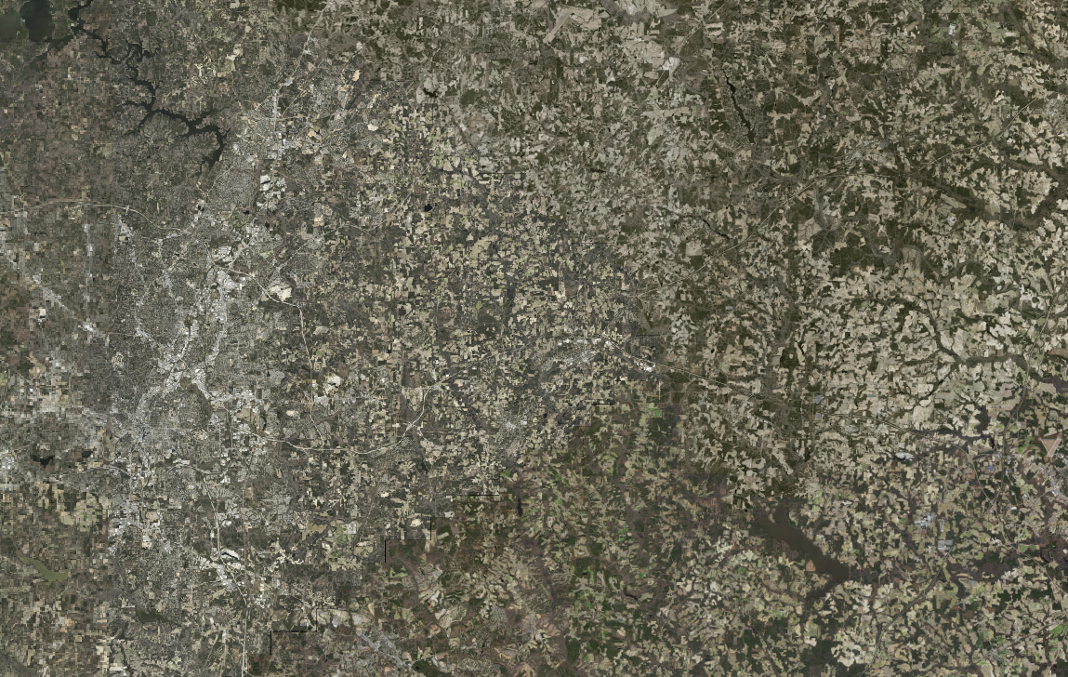
2017 NC Preliminary Orthoimagery

Slide 9
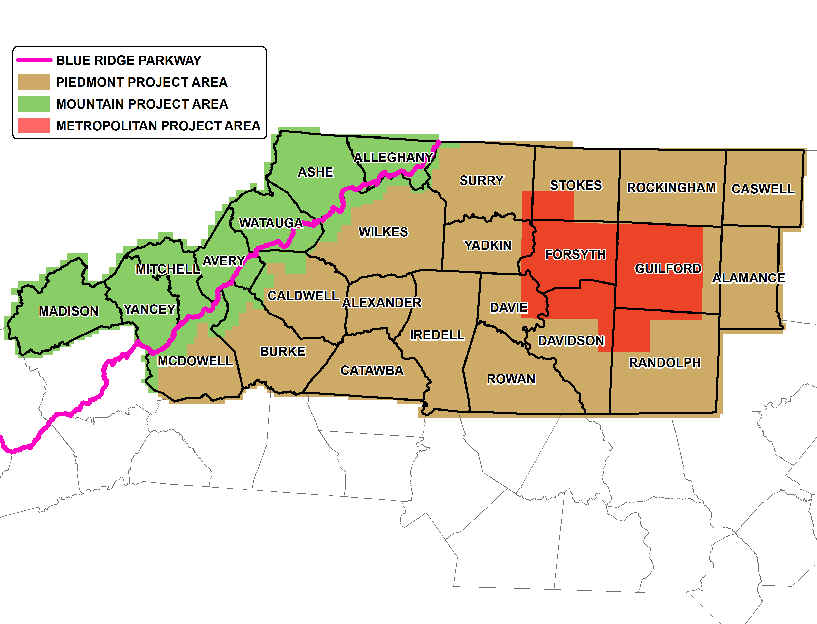
Northern Piedmont and Mountains 2018
Target Earlier RFQ and Contractor Procurement
Local Government Opportunity
Notes:
The area in question is Phase 3 in the progression of statewide 4-year cycle approved last year
Areas in green represent mountain project area (25% of project) with tighter specifications, such as an increased sun angle requirement, more complex flight planning, and ground control that causes an increased per tile cost. [Each tile is 5,000 ft by 5,000 ft on the ground.]
High Point cooperation – In 2014, High Point was able to see additional value in the project by acquiring a higher resolution product (3”) than the regular 6” resolution and in turn provided this to the High Point PSAP for its benefit.

Slide 10
Questions?
Darrin Smith
Technical Project Manager
919.754.6589
darrin.smith@nc.gov
Tim Johnson
CGIA Director
919.754.6588
tim.johnson@nc.gov

