Slide 1
NC Parcels Program
Update for Statewide Mapping Advisory Committee

Slide 2
2017
94 Counties Updated in the NC Parcel Transformer in 2017
52 counties now registered with Transformer
Continuous operation of the cloud application by the Carbon Project, Inc.
Technical assistance from the Working Group for Seamless Parcels/CGIA/NC OneMap
Cost share from NCDOT, NCDA&CS and CGIA

Slide 3
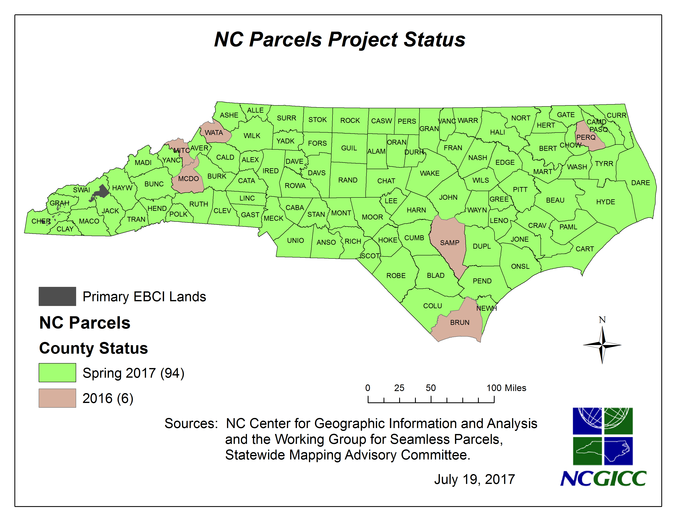

Slide 4
Next Steps
Plan for the fall update
Operate and maintain
Provide technical assistance
Continue to build stock of “do-it-yourself” counties
Continue to improve population of priority data fields
Find a solution for sustainable, full funding to operate and maintain statewide parcels
Consult with the Working Group for Seamless Parcels

Slide 5

Questions?

