Slide 1
Current Lidar Updates

Slide 2
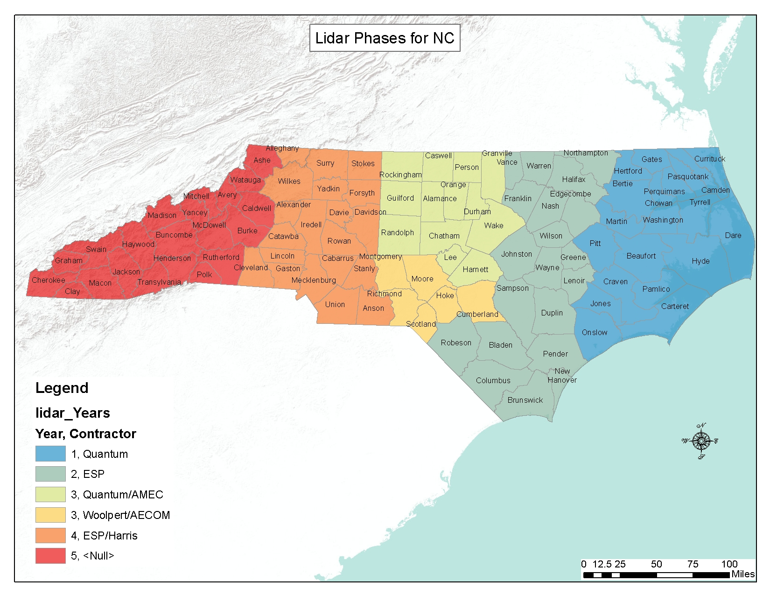
Lidar Phases
Phase 4 – currently in Processing
Phase 3 – Acquired and available @ 2ppsm
Phase 2 – Acquired and available @ 2ppsm
Phase 1 – Acquired and available @ 2ppsm
Phase 5 – Currently in Collection
All available Data will be provided on rmp.nc.gov/sdd

Slide 3
Collection for Phase 4- 07/13/2017
Collection is Complete

Slide 4
Task | Description | % Complete
1b | Geiger-mode LiDAR Data Acquisition | 100%
1a | Planning, Coordination, Flight Operations, and Specs | 100%
1c | Calibration | 100%
2 | Ground Survey Support for Acquisition | 100%
3 | Classification of LiDAR Points | 65%
4 | Development of DEMs in ESRI Grid Format | 60%
5 | Terrain Datasets by County | 5%
6 | High Detail Road and Bridge Classifications | 100%
7 | Intensity Images | 75%
8 | Building Change Detection | 35%
9 | Quality Assurance/Quality Control Plan | 89%
10 | Preparation of Project Reports | 90%
11 | Metadata | 100%
12 | Spatial Data Download Enhancement | 75%
Project Total: |  | 78%

Slide 5
Clip and Ship

Slide 6
Phase 5 collection Complete

Slide 7
Questions

