Slide 1
SMAC
July 19, 2017
Notes:
I will provide some updates from NC Geodetic Survey, then go into a discussion of Elevation Certificates.

Slide 2
Geodetic Control/2022 Reference Frame

Slide 3
New Datums Are Coming in 2022!
Created a 2022 Datum Working Group to develop implementation recommendations
Working with SC Geodetic Survey to develop common implementation plans
Obtaining ellipsoidal heights on NAVD88 bench marks
Speaker at the National Geodetic Survey’s Geospatial Summit

Slide 4
New Reference Frame Names
NAD 83 becomes:
North American Terrestrial Reference Frame (NATR2022)
Caribbean Terrestrial Reference Frame (CTRF2022)
Mariana Terrestrial Reference Frame (MTRF2022)
Pacific Terrestrial Reference Frame (PTRF2022)
NAVD88 becomes:
North American-Pacific Geopotential Datum of 2022 (NAPGD2022)
Realized by GEOID2022

Slide 5
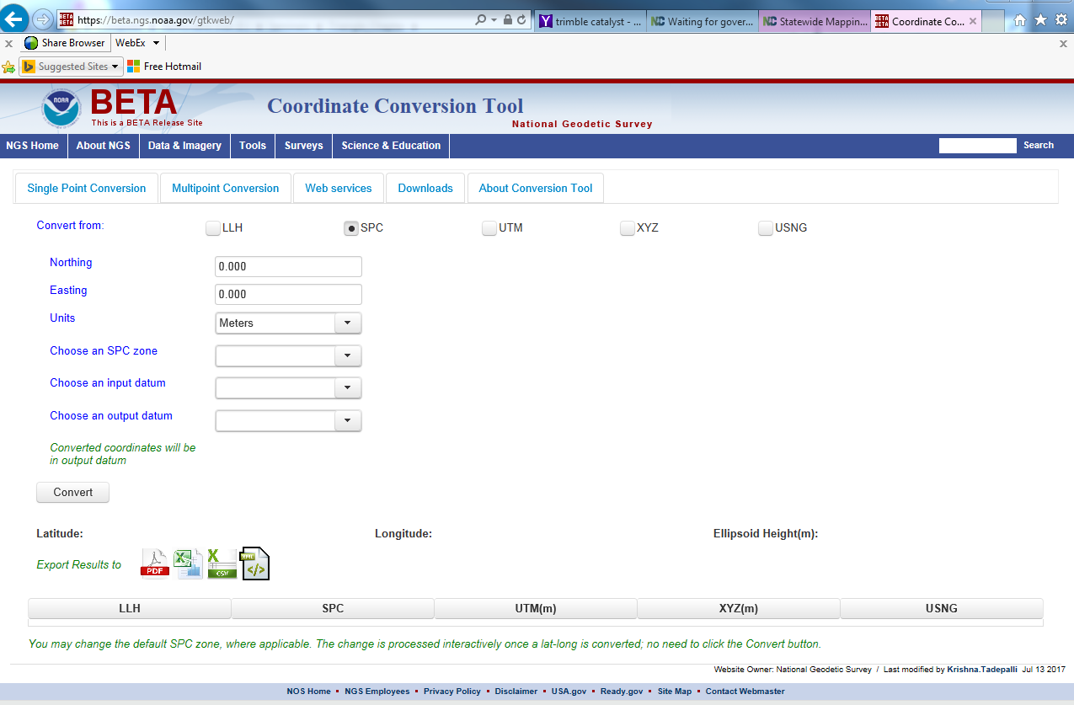
NADCON 5.0
https://beta.ngs.noaa.gov/gtkweb/

Slide 6
County/State Boundaries

Slide 7
Completed!!!

Slide 8
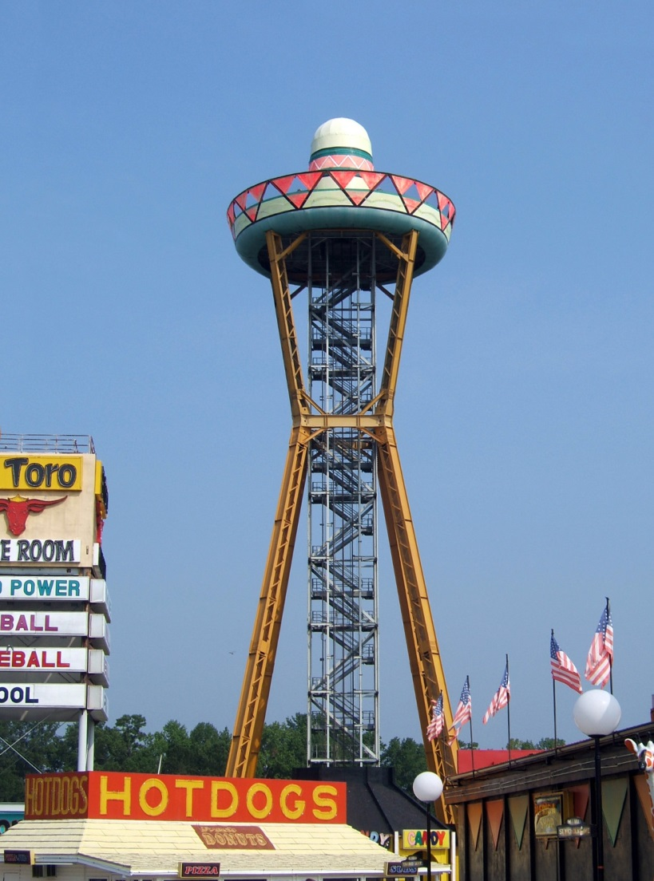
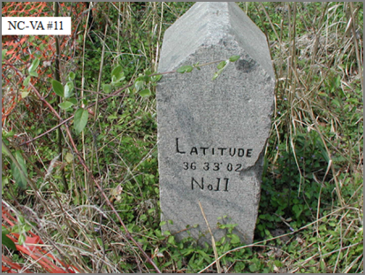
NC-SC Boundary Project
334-mile NC-SC boundary project complete
Plats have been recorded in all border counties
GIS Data is available from NCGS
watson.ross@ncdps.gov
Beginning work on NC-VA Boundary
Source: WikimediaCommons

Slide 9
County Boundary Surveys
Mitchell-Yancey
Cabarrus – Rowan
Harnett – Wake
Alamance – Guilford
McDowell – Mitchell
Bladen – Columbus – Brunswick
Greene – Lenoir (plats recorded)
Chatham – Harnett
Jackson – Macon
Davie – Yadkin
Granville – Franklin
Rutherford – Polk
Chowan - Perquimans

Slide 10
