Slide 1
Screen Reader Demo
John Cotter
N.C. Department of Information Technology
April 28, 2026

Slide 2
What is a Screen Reader?

Slide 3
A Screen Reader is…
Assistive Technology (software)
Used by people who are blind or have low vision
A tool to test content for digital accessibility

Slide 4
Desktop & Mobile
"Desktop" Screen Readers
  Windows
    NVDA
    JAWS
    Narrator
  Mac
    Voiceover
Mobile Screen Readers
  Android Talkback
  iOS Voiceover

Slide 5
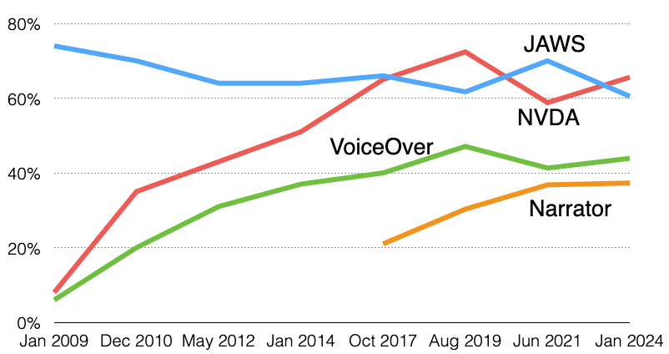
Desktop Usage
https://webaim.org/projects/screenreadersurvey10/#used
Notes:
WebAIM Screen Reader User Survey
1539 respondents
NVDA 65.6%
70% of respondents said they use more than one screen reader

Slide 6
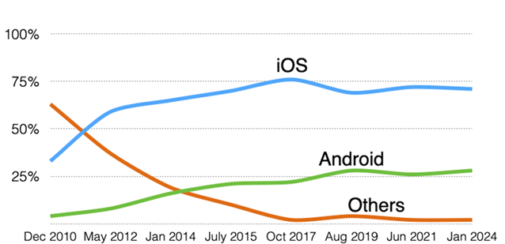
Mobile Usage
https://webaim.org/projects/screenreadersurvey10/#mobilescreenreaders
Notes:
Voiceover 70.6%

Slide 7
Try a Screen Reader
NVDA (free download)
https://www.nvaccess.org/download/
JAWS (purchase)
https://vispero.com/lp/download-jaws/
OSX Voiceover (how to turn on)
https://support.apple.com/guide/voiceover/turn-voiceover-on-or-off-vo2682/mac
Windows Narrator (how to turn on)
https://support.microsoft.com/en-us/windows/chapter-1-introducing-narrator-7fe8fd72-541f-4536-7658-bfc37ddaf9c6#WindowsVersion=Windows_11&windowsversion=windows_11
When installing software, comply with your organization's software approval process and State agency’s guidelines, policies, and standards governing installation and use.

Slide 8
NVDA Settings

Slide 9
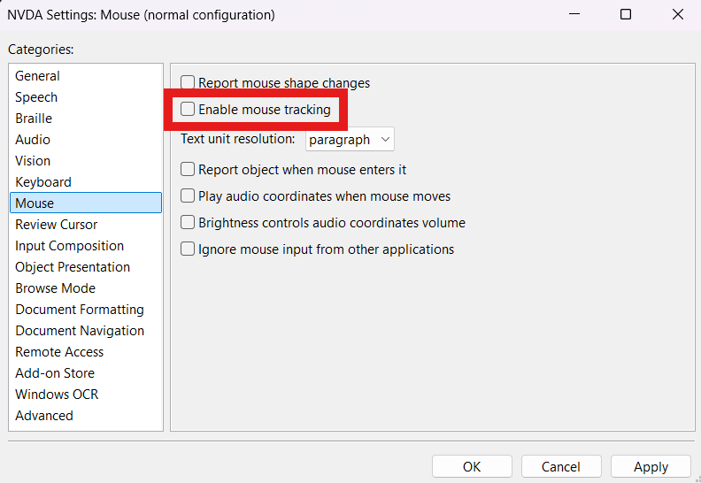
Turn off mouse hover speech (highly encouraged)
NVDA → Preferences → Mouse
Notes:
Enable mouse tracking is default – you will probably want to turn this off.
Useful for a person with low vision who might still use a mouse.

Slide 10
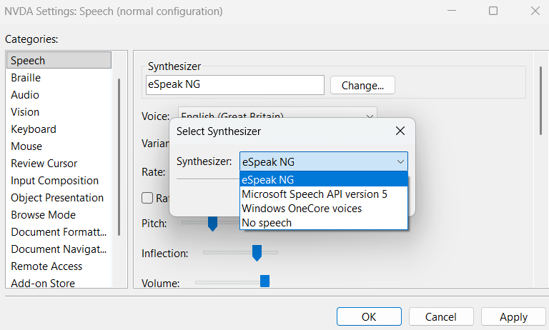
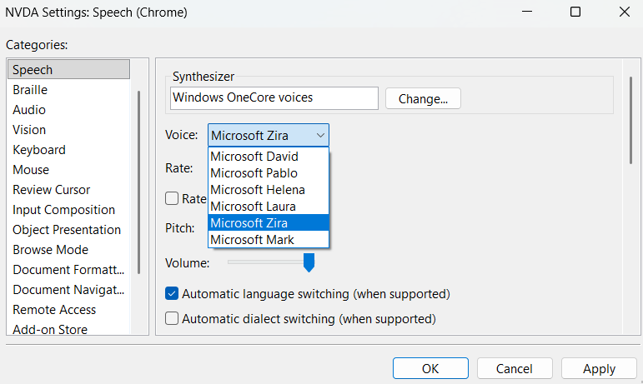
Change Voice Synthesizer
NVDA → Preferences → Speech → Synthesizer
  eSpeak NG
  sounds "robotic", great for fast speech rates
  Windows OneCore voices sounds natural
Notes:
The default is Windows OnCore voices – David.
I like Zira

Slide 11
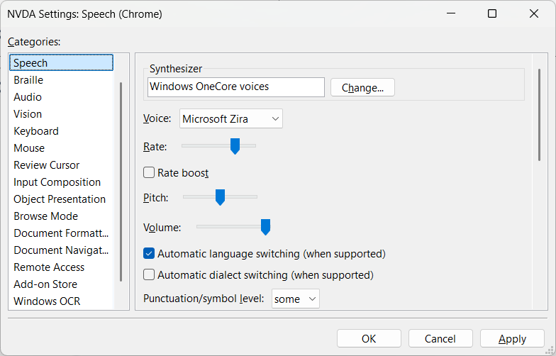
Adjust Speech Rate
NVDA → Preferences → Speech → Rate

Slide 12
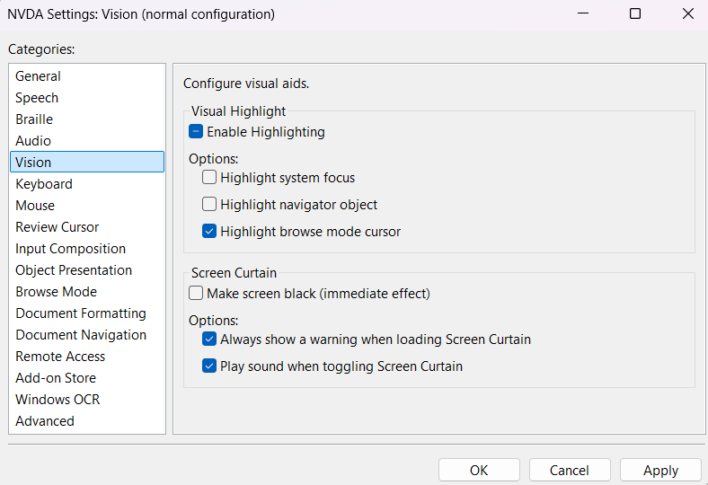
Turn on Visual Highlighting
NVDA → Preferences → Vision

Slide 13
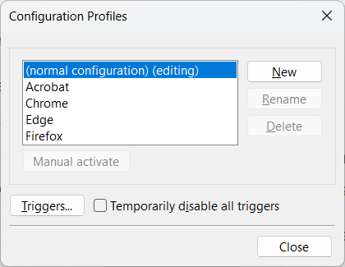
Speak only in browsers and acrobat (advanced)
As a web content accessibility tester, I want NVDA to speak only in browsers and adobe acrobat.
NVDA →Configuration Profiles
Instructions here:
https://stackoverflow.com/questions/74454539/running-nvda-screen-reader-on-a-single-application

Slide 14
General Navigation
Key | Command
Ctrl | Temporary mute (stops speech immediately) MOST IMPORTANT THING TO KNOW
Arrow Down Arrow Up | Read next item Read previous item
Arrow Left Arrow Right | Read char-by-char
Tab Shift + Tab | Navigates forward in tab order Navigate backward in tab order

Slide 15
Browse Mode / Focus Mode
Browse Mode: For general page reading
Focus Mode: For input (forms, links, buttons).
Sometimes called "Forms mode"
Notes:
JAWS calls this virtual PC cursor / forms mode
Narrator – Scan mode on/off
Voiceover – no explicit modes

Slide 16
What different screen readers call the navigation modes
Screen Reader | Mode 1 (read) | Mode 2 (forms) | Mode 3 (passthrough)
NVDA | Browse | Focus | Application
JAWS | Virtual Cursor | Forms | Application (PC Cursor)
Narrator | Scan Mode | Input | Pass-through
VoiceOver | VoiceOver Cursor | Interaction | Pass-through
role=application triggers pass-through modes
Notes:
JAWS calls this virtual PC cursor / forms mode
Narrator – Scan mode on/off
Voiceover – no explicit modes

Slide 17
Mode Notes
Modes may change depending on what has focus.
Sound effects play when modes change.
Users can change modes manually
Key | Command
Ins + Spacebar | Toggle between Browse mode and Forms mode

Slide 18
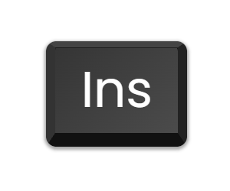
Screen Reader Modifer Keys
Users send special commands to their screen reader using the
"screen reader modifier key".
Usually called the NVDA key, JAWS key, VoiceOver key
In NVDA, the default is the Ins key
In a list of shortcuts, NVDA + N, that means Ins + N

Slide 19
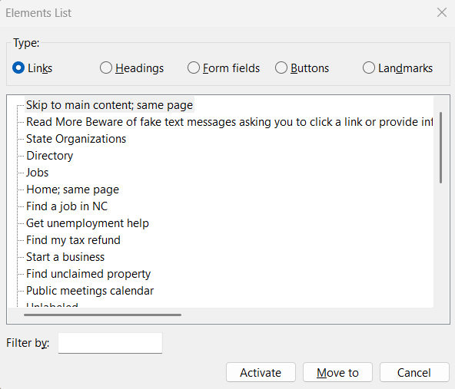
Elements List
Key | Command
Ins + F7 | Show Elements List
Notes:
What's missing? (graphics) (tabs appear in form fields)
The elements list is designed around navigation targets.
Click here example

Slide 20
Navigate by Element Type
Key | Command
h | headings
g | graphics
d | landmarks
k | links
l | lists
t | tables
Use shift to navigate to previous element (shift + h)

Slide 21
Table Navigation
Key | Command
Ctrl + Alt + Arrows | Move through the table
Notes:
https://digitalcommons.nc.gov/guide/help-topics/how-create-accessible-tables-text-editor

Slide 22
Mobile Screen Readers

Slide 23
Mobile Screen Reader Actions
Swipe through linear reading order
Scan page with finger by dragging
Double Tap to activate controls
Navigate by Headings, Links, Landmarks, etc.
  Voiceover Rotor – two finger twist gesture
  Talkback Reading Controls – three finger swipe down/up

