Slide 1
NCDIT
Technology Strategy Board
March 19, 2021

Slide 2
Agenda

Slide 3
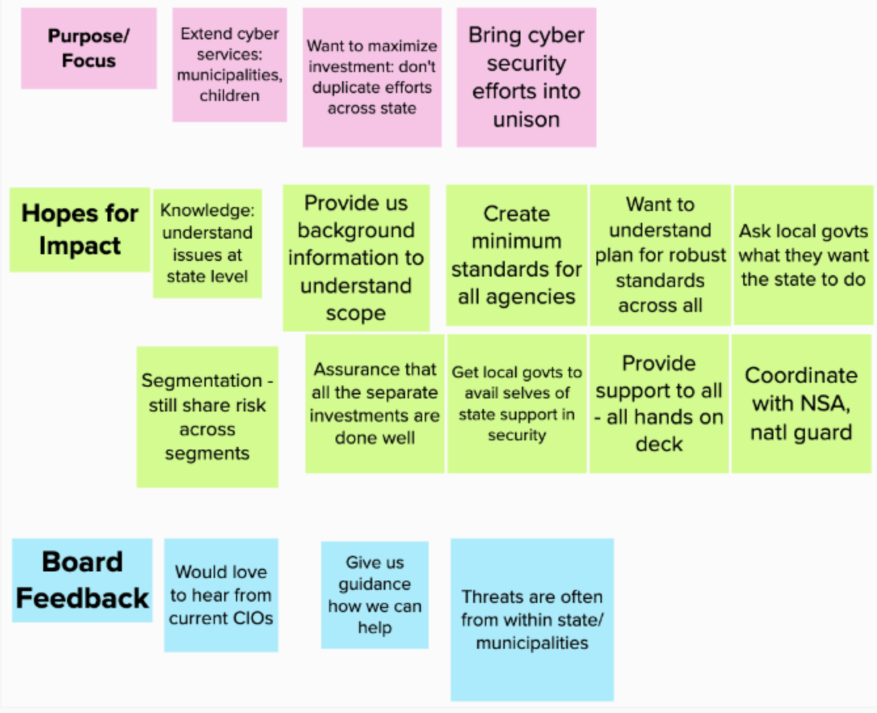
Committees and Working Groups
Cybersecurity
This committee will:
Identify potential funding mechanisms to enhance the state’s cybersecurity efforts, Facilitate the strategic development of cyber workgroups or tiger teams to implement statewide cybersecurity initiatives, Promote public/private information sharing through collaboration and integration, Propose improvements to state cyber laws, directives and awareness, Develop strategies to address state cyber personnel shortfalls, and Facilitate economic development for North Carolina by promoting and improving the cyber ecosystem for State businesses and residents.

Slide 4
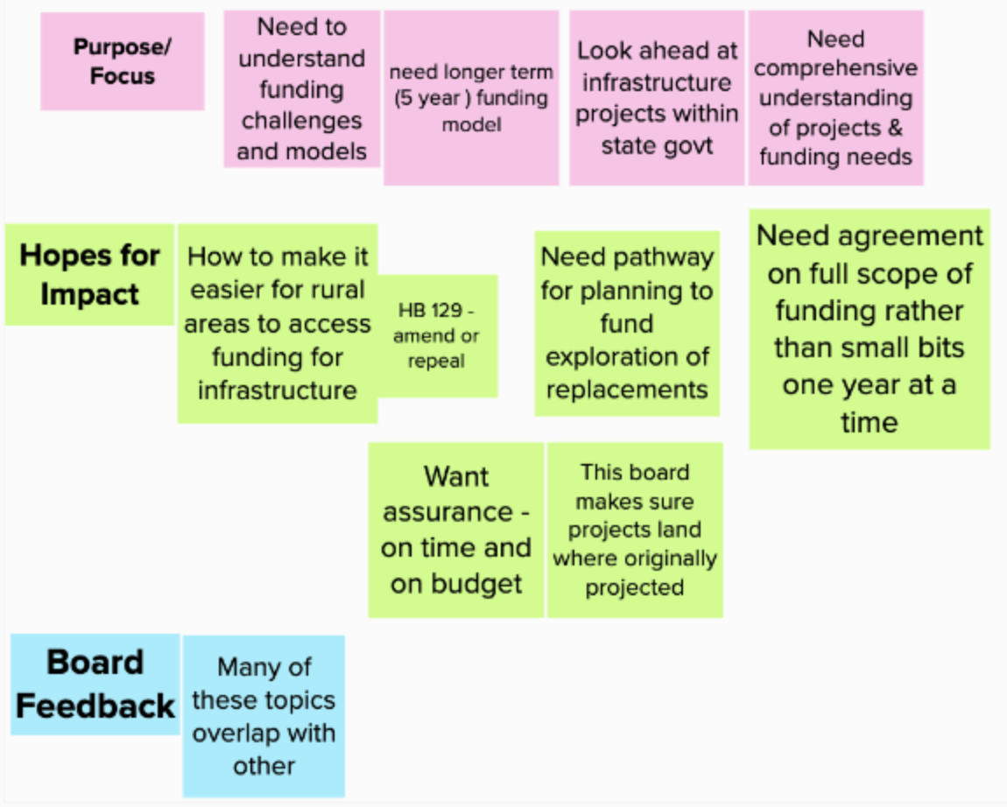
Committees and Working Groups
Infrastructure Funding
Funding for IT represents a substantial investment of taxpayer resources. Likewise, there is need for significant additional state investments in IT to enable state agencies to make improvements and find efficiencies that benefit NC residents.
This committee will:
Take a comprehensive approach to reviewing proposed IT enhancements across all state agencies and vet projects to understand their importance and cost. This committee will also look for creative funding opportunities and advocate for high-priority projects to receive funding in the appropriation process.

Slide 5
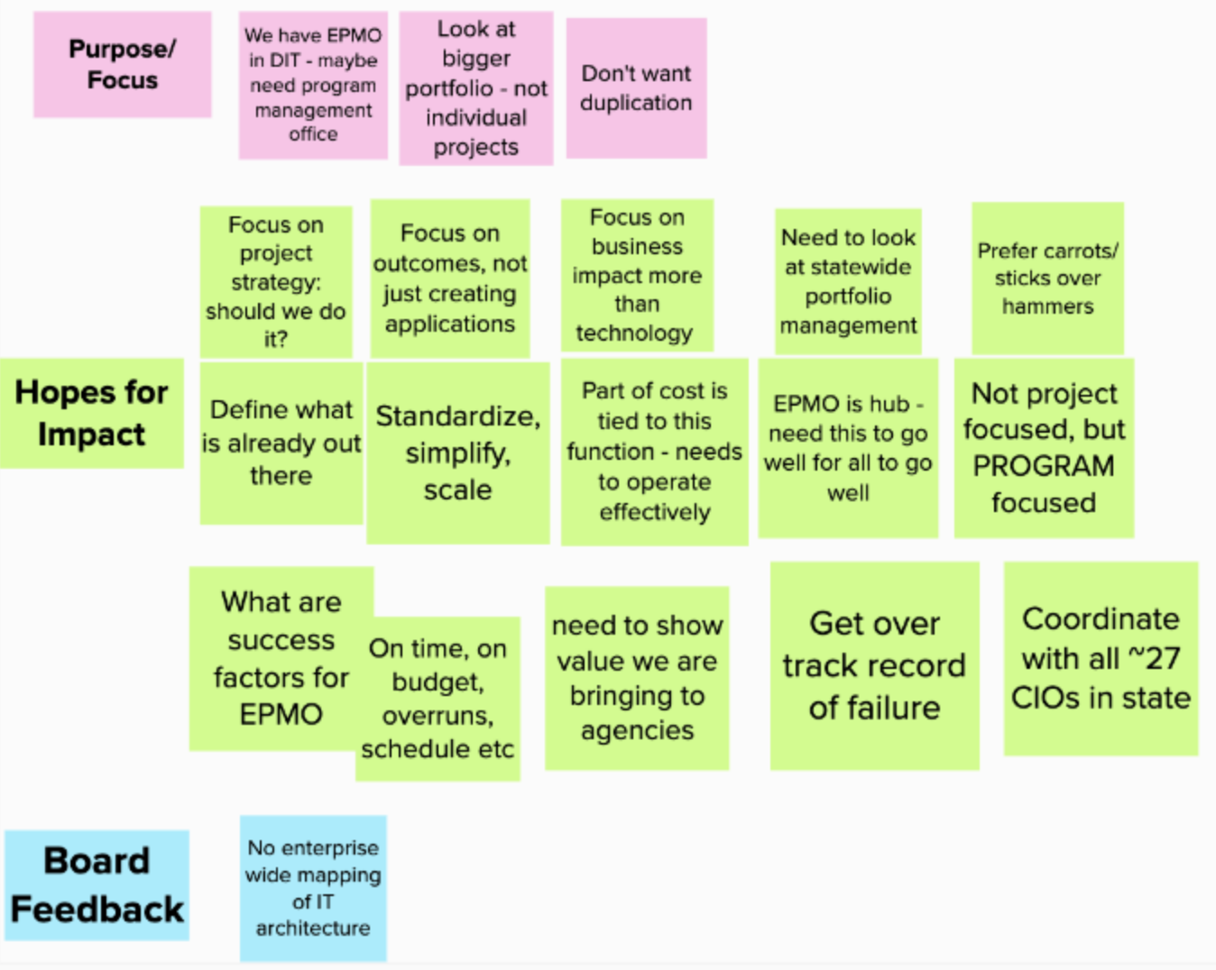
Committees and Working Groups
Enterprise Project Oversight Enhancement
This committee will:
Work with the EPMO and the many participants in the IT solution procurement and development lifecycle to better address the current IT landscape and business needs. This includes determining critical roles/functions that should be required during projects such as contract/vendor management, organizational change management and testing. This committee’s work will help ensure appropriated funds are being invested wisely.

Slide 6
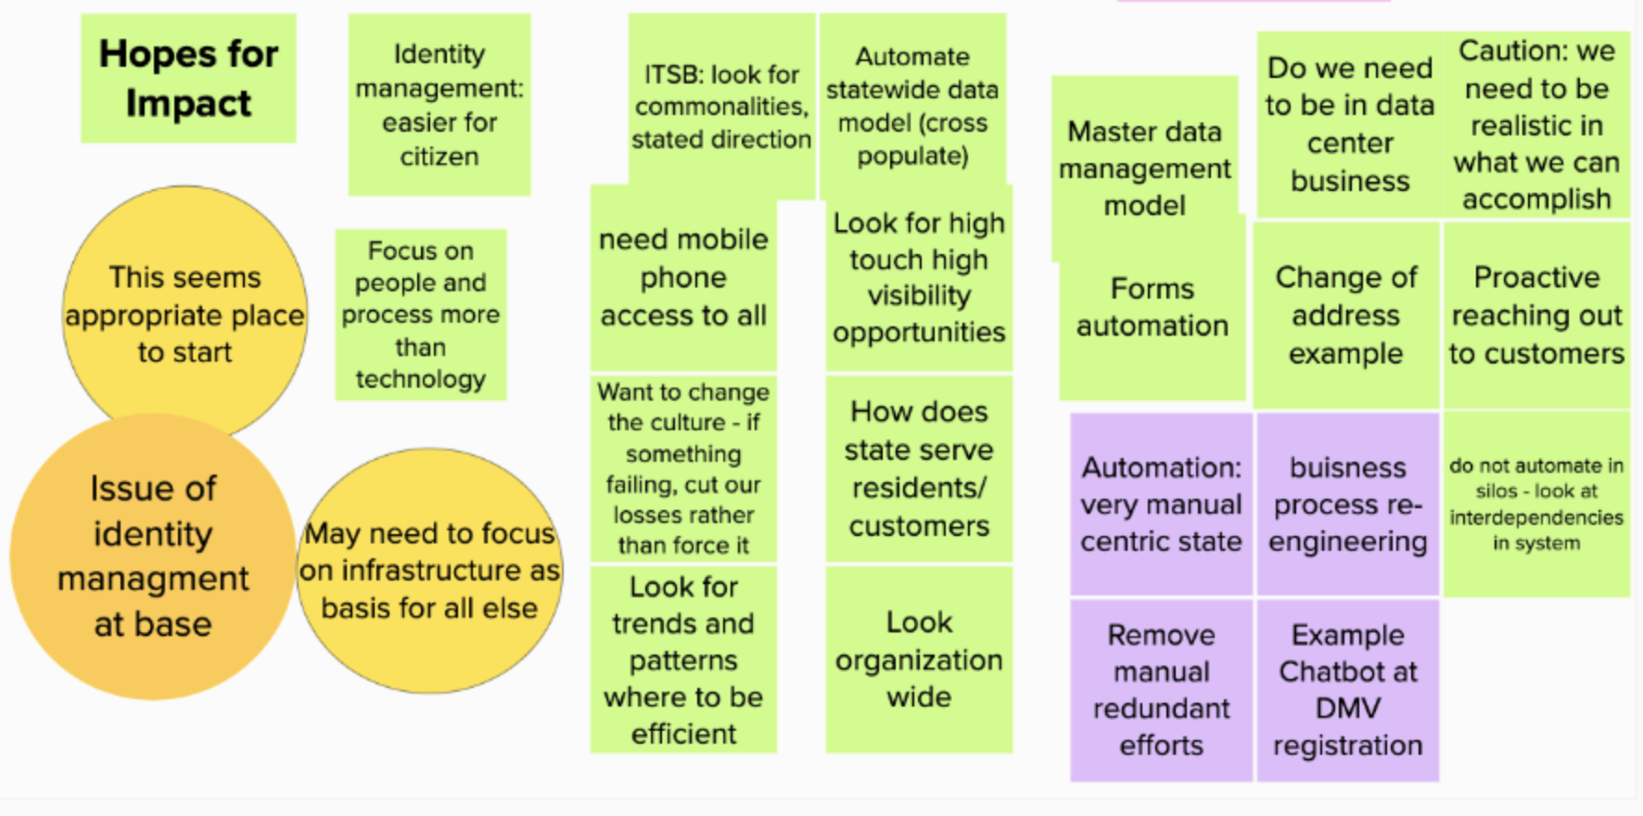
Committees and Working Groups
Digital Transformation
This committee will focus on:
Connectivity
Cybersecurity
Privacy
Cloud Computing

Slide 7
Next Steps: Committees
Role:
To identify and share industry best practices and new development and to identify existing state IT problems and deficiencies (from statute)
To more deeply explore and understand specific topics of importance
Time commitment: Up to one meeting per month, plus preparation for meeting; committees may be ongoing or time-limited.
Staff Support: DIT staff supports committee – prepares meeting agendas, minutes, and background materials/reports.
Other Support: May need to bring technical advisors in for some discussions; Fountainworks will support for meeting facilitation/process guidance.

Slide 8
Next Steps: Sample Cycle for Board, Committees, Technical Advisory Groups
Full Board Meeting
Committees, T.A. Groups Meet
Full Board Meeting
Board Chair will appoint Committees and Technical Advisory Groups
Committees will meet at least once in between Board meetings. Technical Advisory Groups will meet as needed
Will report to the Full Board at the subsequent meeting
Once committees/T.A. Groups are created, milestones and deliverables will be established

