Slide 1
NCID Simieo SAML Solution
NCID Team
Simeio Team
25 January 2024

Slide 2
Centralizing Access Management for Applications
Ping Federate will deliver these connections:
SAML - Available Now in Dev, Pre-Prod & Prod
SAML with MFA
SMS & Email - Available Now in Dev
Voice & Push – Will be in DEV week of Feb 12th based on Simeio IO 10.4.3
OIDC - Second quarter 2024
HTTP Proxy – Late in second quarter 2024

Slide 3
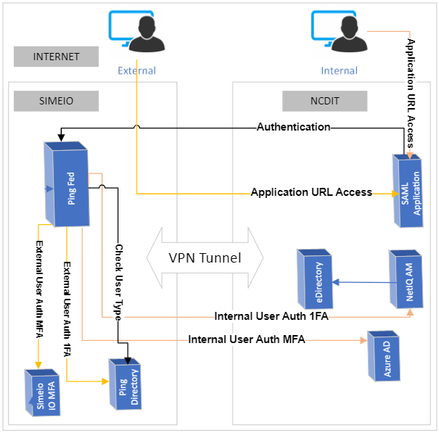
Ping Federate SAML

Slide 4
Ping Federate SAML
A user attempts to access the application protected by the PingFederate using the SAML protocol.
The user is redirected to the PingFederate server for authentication if the session does not exist.
If the session already exists, the user is granted immediate access.
Ping Federate checks the user type over Ping Directory
For internal users, the PingFederate server redirects the user’s browser to NetIQ AM(1FA) or Azure AD (MFA) for authentication using the SAML protocol. The IdP partner authenticates the user and returns a SAML assertion. PingFederate validates the assertion and then redirects the browser to the Application including the assertion.
For external users, The PingFederate authenticates the user against Ping Directory (1FA) and/or Simeio IO (MFA). PingFederate creates the assertion for the user including any configured attributes. PingFederate then redirects the browser, including the assertion back to the Application.
The Application verifies the assertion and grants access to the protected resource, as appropriate.

Slide 5
Onboarding Proces - SAMs
DEV Onboarding - SAML
Application contact will return Questionnaire to Simeio with Dev Metadata/Certificate, URL and the contact information for the person configuring the Application.
Simeio will configure the Application in Ping Federate Dev.
Simeio will send the Ping Metadata and URL for Dev to the Application contact .
Application contact will configure Ping IDP in the Dev application.
Simeio will schedule the Dev configuration meeting to test the configurations are working.
Together Simeio and the Application contact will set the schedule for Pre-Prod.
Notes:
*If smoke test fails the Application contact will revert to previous SSO.

Slide 6
Onboarding Process
Pre-Prod Onboarding - SAML
Application contact will provide Simeio with Pre-Prod Metadata/Certificate and URL.
Simeio will configure the Application in Ping Federate Pre-Prod.
Simeio will send the Ping Metadata and URL for Pre-Prod to the Application contact.
Application contact will configure Ping IDP in the Pre-Prod application.
After configuration in Pre-prod is complete, the application owners will test in Pre-Prod.
Plan for Application Testing requirements
Once Testing has passed, together Simeio and the Application contact will set the schedule for Prod.
Notes:
*If smoke test fails the Application contact will revert to previous SSO.

Slide 7
Prod Onboarding - SAML
Application contact will provide Simeio with Prod Metadata/Certificate and URL.
Simeio will configure the Application in Ping Federate Prod.
Simeio will send the Ping Metadata and URL for Prod to the Application contact.
Application contact will configure Ping IDP in the Prod application.
After configuration is complete in Prod, the application owners will execute their smoke test and Go Live.
The Application name and support contacts will be published in the Ping Federate Apps list.

Slide 8
Questionnaire Review

Slide 9
Questions?

