Slide 1
Exchange User’s Group January 2015
Unified Communication / Email & Archive

Slide 2
Agenda
Overview
Accomplishments to date
Timeline
Migration Readiness
Training End Users
New Admin Portal Overview and Training
EDiscovery update
Retention
NCID transfers
New account workflow changes on 12/21
Billing Info

Slide 3
O365 Program Overview
Overall Objectives:
Address historical licensing challenges
Address supportability issues by moving email & archive systems to the cloud in a subscription model
Current priorities of the O365 program
Connect our environment with the cloud and establish the state’s Office 365 platform
Migrate on premises mail to the cloud
Migrate on-premises archive to the cloud
Rollout G3 licenses (Office 2013) as Agencies convert to the master agreement
Initial emphasis is on migrating On-Premises capabilities to O365
Additional Value Added services are enabled as a secondary priority
Lync
SharePoint
OneDrive

Slide 4
O365 Accomplishments to-date
Infrastructure ready
Agency Migration Planning Meetings held
ITS and NCCOB, Office 2013, Email/Archive complete
OSBM, OSHR Email/Archive complete
DOT, DHHS, AGR, Consolidation Agencies Email Migrating and Office Deployment
Inactive Archive users complete
Added O365 End User / Admin resources to LMS
SharePoint Governance Complete
ITS and WRC Lync migrated

Slide 5
Office 365 Program Timeline
FY 13/14 | FY 14/15 | FY 15/16
Q4 | Q1 | Q2 | Q3 | Q4 | Q1 | Q2 | Q3 | Q4
Email
Email
Platform Enablement
User Migration
Archive
Contract or SOW
Award
Inactive user migration
Active user migration
Office
Agencies Migrate based on Enterprise Agreement and Readiness
Lync
ITS Migrate
Agency’s either migrate, implement or not use.
SharePoint
Governance developed
Agency’s either migrate, implement or not use.

Slide 6
Migration by Month

Slide 8
Overall Email Migration Progress

Slide 9
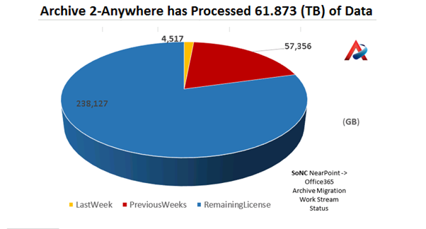

Slide 10
What needs to be done before Migration?
Client operating system and applications
Office and Browser, Sign in assistant if 2010.
Outlook and IE configuration updates
Application testing
User communications
Provide batches of users (with dependencies)
Training (User and Admin)
Mailbox size reduction <20GB
Migration Schedule Planning
Mitigate issues with departed users
Make into service account, add as proxy, or delete account
Notes:
This Remediation Checklist represents the list of activities to address any outstanding items that serve as entrance criteria for the Migration phase
Review Prep:
Preparation:
Pre-reading: Office 365 Enterprise Service Descriptions - http://technet.microsoft.com/en-us/library/jj819284.aspx
If appropriate, Customer infrastructure diagrams (Network, AD, etc.)
Number of clients
Estimated peak usage (example 60% login within 1 hour)
Version and counts (include macs and mobile devices)
RDS/Citrix/VDI versions and counts
Version of OS/Citrix/Office/Browsers
Who does the Level 1/2/3 service desk support for client, desktop, messaging, identity?
Security
Proxies, F5’s etc.
Data Loss prevention
2-factor Authentication (any restrictions)
DLP encryption tools if used
What makes you special
Things that are unique
Any deadlines or freezes
Government Compliance (CJIIS, IRS 1075, etc.)
Full Remediation List:
Addressing Active Directory multi-forest
Active Directory attributes for Directory Synchronization
Network for migration and run-state
Capacity
Connectivity
Mailbox size reduction
Migration Schedule Planning
Client operating system and applications
Office and Browser
Other items outside of Service Enablement Plan scope as needed

Slide 11
ITS Client readiness and support
Readiness
Office 365 ProPlus installed
Outlook User Account settings validated
IE, Office and Windows version n or n-1 for full support
Microsoft supported client software
 | Fully supported | Limited support with diminished user experience | Unsupported
Internet Explorer | IE10 & above | IE8* & IE9 | IE7 & Lower
Office All Office updates need to be installed | Office 2010 & above | Office 2007 SP3 | Office 2003
Windows OS | W7 & above | XP SP3 | XP SP2
* IE 8 will offer only OWA Lite Mode, OL Cached Mode
Notes:
Outlook Settings:
On Fast networks always use HTTPS
Cached Mode
Office 365 ProPlus
http://office.microsoft.com/en-us/business/office-365-proplus-business-software-FX103213513.aspx

Slide 12
Web Experience Clients
Requires a recent version of the following browsers:
Internet Explorer 9,10 or higher, IE8 goes Lite in April 2014
Firefox 3 or later
Chrome 3.0.195.27 or later
Safari 3 or later on Macintosh OS 10.5
Internet Explorer, Firefox, Chrome, and Safari are all tested simultaneously and there should be no or little feature lag between browsers. HTML 5 may start being integrated in the near future
Outlook Web App is a powerful web-based version of the Outlook client that provides most of the same features and functionality of the Outlook client.
Notes:
The web experience is suitable for users in larger businesses that do not have a dedicated computer. Office 365 has solutions for these “kiosk workers,” giving them access to email and company information via a web browser.
This link lists the operating systems and Microsoft Office software that are supported by Office 365. http://office.microsoft.com/en-us/office365-suite-help/office-365-system-requirements-HA102817357.aspx
Web browsers: Internet Explorer
Office 365 is designed to work with the current or immediately previous version of Internet Explorer. We recommend that you upgrade to the latest version of Internet Explorer after it is released. Office 365 might continue to work with versions of Internet Explorer other than the current and immediately previous versions for some time after the release of a new version of Internet Explorer, but Office 365 can’t provide any guarantees.
When accessing Office 365 from older versions of Internet Explorer, users may experience known issues and limitations depending on the versions of Internet Explorer, including:
Internet Explorer 9 Office 365 does not offer code fixes to resolve problems you encounter when using the service with Internet Explorer 9. You should expect the quality of the user experience to diminish over time, and that many new Office 365 experiences might not work at all.
Internet Explorer 8 The user experience sending and receiving email with Outlook Web App and Internet Explorer 8 might be substantially diminished, especially when used on Windows XP or with low memory devices. Office 365 does not offer code fixes to resolve problems you encounter when using the service with Internet Explorer 8, and new Office 365 experiences might not work at all.
You should also expect the quality of the user experience with Internet Explorer 8 to diminish further in the near future. Beginning in May 2014, Internet Explorer 8 will only display Outlook Web App Light. If you are an Office 365 admin, you will see a notification of this change in the Message Center in the Office 365 admin center 30 days before the change takes place.
If your organization is dependent upon Internet Explorer 8 to access older Web apps and services, you may want to consider upgrading to Internet Explorer 11 and evaluating Enterprise Mode for Internet Explorer 11. This update helps provide better backward compatibility for legacy Web apps."
Web browsers: Firefox, Chrome, and Safari
Office 365 is designed to work with the current or immediately previous version of Firefox, or the latest version of Chrome or Safari. Microsoft supports only browser versions that are also supported by the browser’s manufacturer. Typically, this is only the most current version. Firefox and Chrome are both designed to stream updates your devices every six weeks. Many common problems with these browsers are resolved in the next update.

Slide 13
Training Content
Review existing end user training materials available for Office 365
ITS Provided Training
Microsoft Office readiness content
Microsoft Office 2013 End User Training Resources
http://technet.microsoft.com/en-us/library/jj871004(v=office.15).aspx

Slide 14
NC LMS
Email Training
Email Admin Training and Videos
End user Office Training
Post Email Migration Info and What’s going to Change?
Holiday Import Directions and PST
Notes:
This Remediation Checklist represents the list of activities to address any outstanding items that serve as entrance criteria for the Migration phase
Review Prep:
Preparation:
Pre-reading: Office 365 Enterprise Service Descriptions - http://technet.microsoft.com/en-us/library/jj819284.aspx
If appropriate, Customer infrastructure diagrams (Network, AD, etc.)
Number of clients
Estimated peak usage (example 60% login within 1 hour)
Version and counts (include macs and mobile devices)
RDS/Citrix/VDI versions and counts
Version of OS/Citrix/Office/Browsers
Who does the Level 1/2/3 service desk support for client, desktop, messaging, identity?
Security
Proxies, F5’s etc.
Data Loss prevention
2-factor Authentication (any restrictions)
DLP encryption tools if used
What makes you special
Things that are unique
Any deadlines or freezes
Government Compliance (CJIIS, IRS 1075, etc.)
Full Remediation List:
Addressing Active Directory multi-forest
Active Directory attributes for Directory Synchronization
Network for migration and run-state
Capacity
Connectivity
Mailbox size reduction
Migration Schedule Planning
Client operating system and applications
Office and Browser
Other items outside of Service Enablement Plan scope as needed

Slide 15
NC LMS Training Available

Slide 16
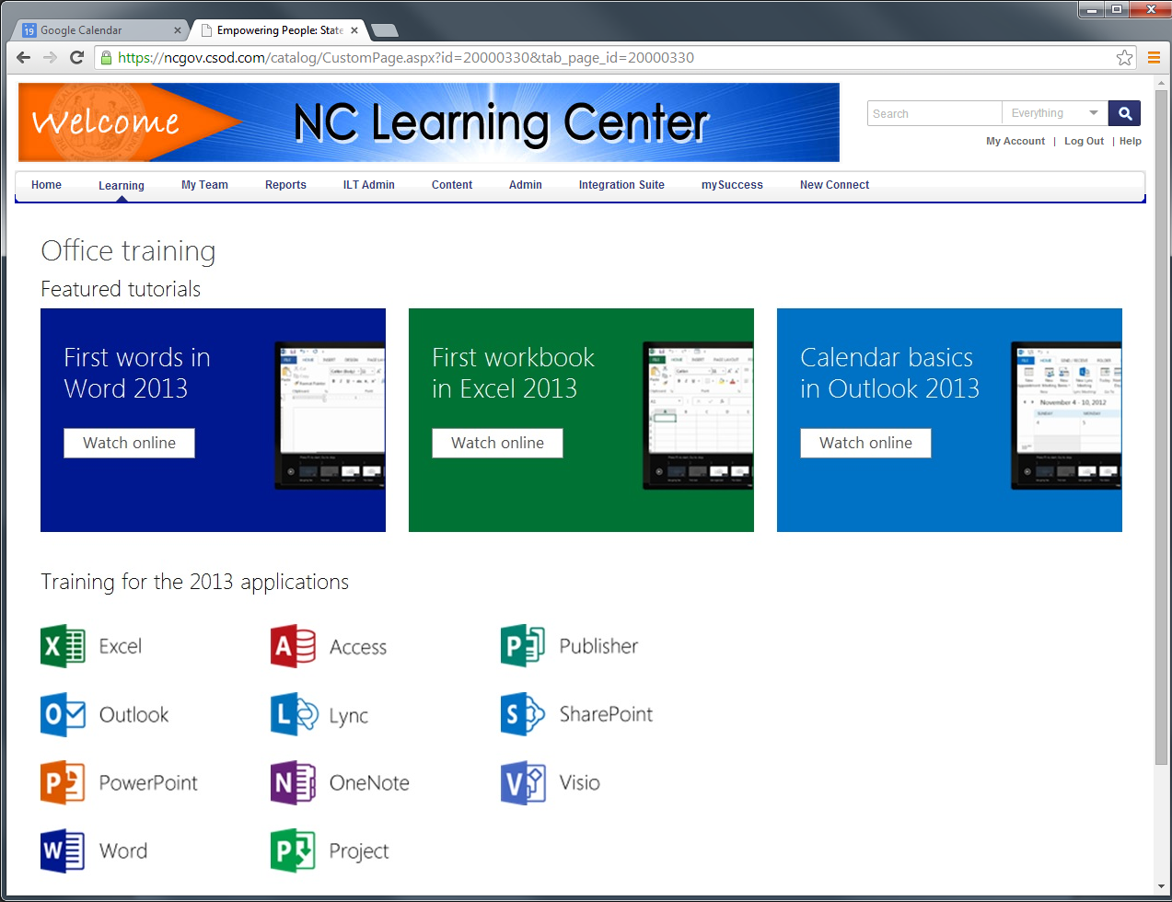
100’s of Courses Available in Office 2010, 2013 and Office 365

Slide 17
Email Admin Portal
Will be released to all Admins by 3/9
Service Accounts can now be created by Admins
Licenses need to be assigned to new users
Currently only G3 Licenses
Outstanding Issue- Adding a calendar resource
Must be done manually until resolved
If you see issues please let us know

Slide 18
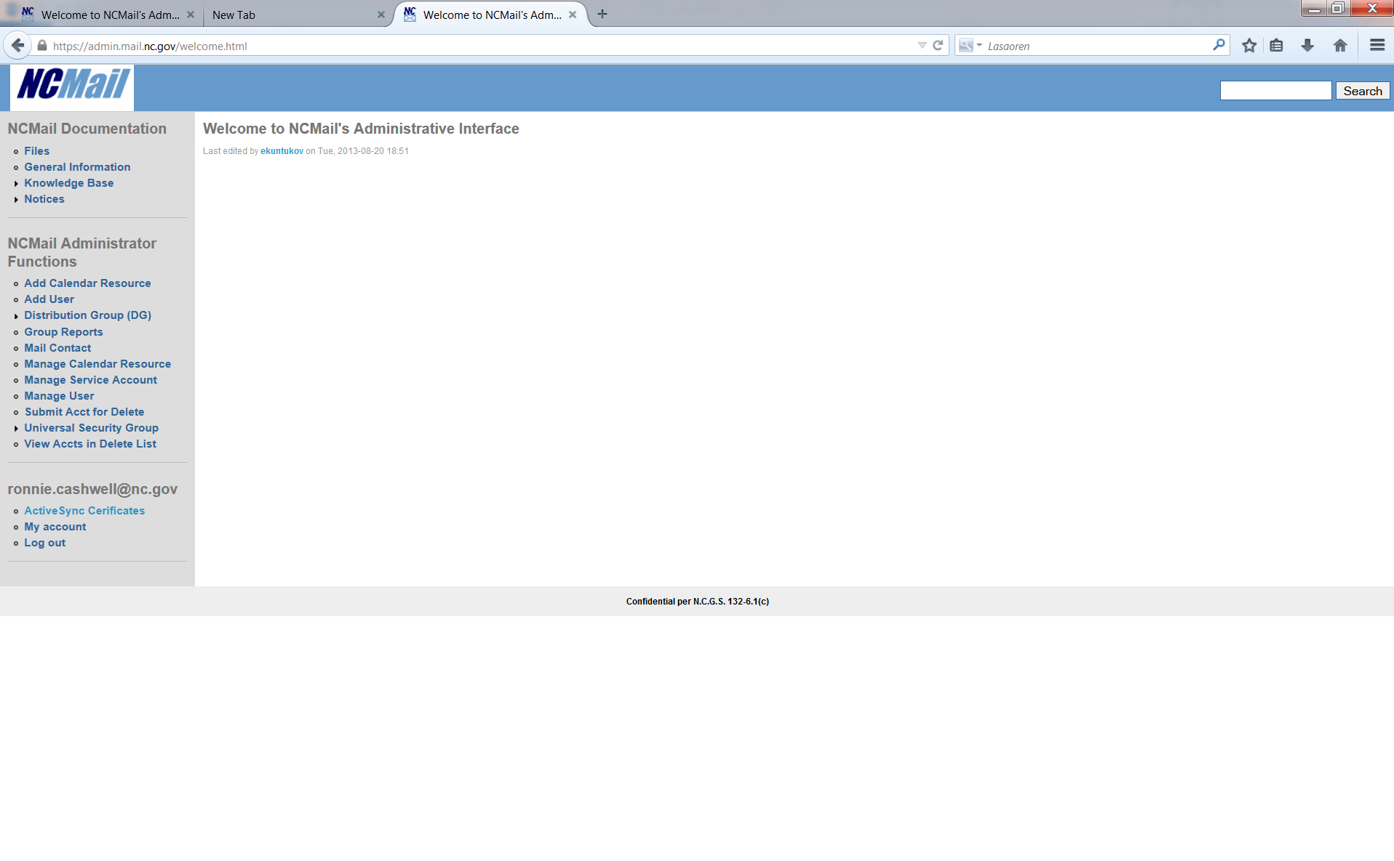
NCMail’s Administrative Interface Changes.
Old Interface
New O365/On-Prem Admin Interface
Manage User Mailbox
Add User
Manage Service Account
Manage User
Submit Acct For Delete
Manage Calendar Resource
View Accts in Delete List
Manage Service Account
Add Calendar Resource
Manage Mail Contact
Manage Calendar Resource
Mail Contact
Manage Distribution Group
Distribution Group (DG)
Universal Security Group
Group Reports
Manage Universal Security Group
Coming With Future Update
Existing Administrators will see changes to the Administrative Interface as shown above. Note some of the Function tab names have changed but the functions still exist in a more consolidated grouping.

Slide 19
NCMail’s Administrative Interface
After you have been assigned Exchange Admin rights, you will sign into the Exchange Admin portal. It will open to this Administrative interface window.
Training is available in the NCLMS under the O365 Curriculum.

Slide 20
Manage User Mailbox
The Manage User Mailbox section will cover Managing On-Premise and Office 365 User Mailboxes.
It will cover Adding an 0365 User Mailbox.
Adding an On-Premise User Mailbox.
Editing either an On-Premise or 0365 User Mailbox.
Submitting On-Prem/O365 Mailbox for Delete
Allows you to View On-Prem/O365 Mailbox in the Delete list. (View Only)

Slide 21
What needs to be done after migration?
If in Outlook, close and reopen 1 or 2 times
Set up OWA
Change your bookmark (Will be redirected until bookmarked)
http://outlook.com/owa/nc.gov
Point your Smartphone Active Sync Profile to outlook.office365.com
Continue to review Office 2013 training especially Outlook 2013 (Located in the NC LMS)
Use the New Email Admin Portal to manage users in both environments
After migration new users should be created in O365 not on prem.

Slide 22
Offline and Cache Settings
The following URL will allow you to adjust the amount of mail you keep off line.
http://office.microsoft.com/en-us/outlook-help/change-how-much-mail-to-keep-offline-HA102821311.aspx
Outlook 2013 now has the ability to support 50GB OST files.
However, The following URL explains some issues including application pauses with large OST files above 10GB.
http://support.microsoft.com/kb/2759052
Ideally you will want to keep the OST file under 5GB.
Up to 5 GB: This file size should provide a good user experience on most hardware.
Between 5 and 10 GB:
This file size is typically hardware dependent.
Therefore, if you have a fast hard disk and lots of RAM, your experience will be better. However, slower hard disk drives, such as drives that are typically found on portable computers or early-generation solid-state drives (SSDs), experience some application pauses when the drives respond.
More than 10 GB:
When the OST file reaches this size, short pauses begin to occur on most hardware.
:

Slide 23
Exchange and Archive Changes
Description | Today | Office 365 | Resolution/Mitigation
Mailbox Limit | 1GB + storage for overage | 50GB | No more overage charges.
Message Limit | 50MB | 25MB | Working with Microsoft on solution to allow <50MB to migrate only. Limit still applies. Users may experience slight delay uploading large attachments.
Email address parameters | Some restrictions | Certain Characters are not valid and no more duplicate names | Run IDFIX and identify issues. Work with Agencies to mitigate
Mobile Device |  |  | Account must be deleted and then added back after email migration.
Manage Dist Groups | Manage in address book or Admin Tool | Email Admin Tool | Email Admins will have to do this on user's behalf
Address Book | GAL broken down by Agency | 1 GAL | Recent update allows more granular breakdown. This will change during ITS migration
Access to archive | 1 folder for Mimosa/Near Point | 2 folders during and 1 after Archive Migration
Retention Policy | 60 and 120 days | 1 year for Email and Calendar | 1 year move to Online Archive or Calendar
Limitations and Boundaries in Exchange online
http://technet.microsoft.com/en-us/library/exchange-online-limits.aspx
Notes:
Exchange Delegated Admin Group will meet monthly over the next 2 months to review migration planning, and then likely move to a Bi-monthly meeting to implement lessons learned.

Slide 24
New Web Interface
Microsoft Online Services Portal is the central access webpage for specific tasks and services.
Displays available administrative tasks based on permissions
OWA SharePoint OneDrive | Download Office ProPlus Perform E-Discovery

Slide 25
Outlook Web App - Email
Mimosa Archive
will show up here
as In-Place/Online
Archive.

Slide 26
Outlook Web App - Calendar

Slide 27
New O365 Archive Folders
Online Archive/In Place Archive
Calendar Online Archive

Slide 28
Email / Archive Retention
Retention
Litigation Hold
Folder | O365 Default | O365 Default
MBX | 1 Year move to Online Archive | 5 Yrs. Total Permanent Hold Exceptions
Calendar | 1 Year move to Calendar Online Archive | 5 Yrs. Total Permanent Hold Exceptions

Slide 29
NearPoint/Mimosa Archive Migration: What Users Can Expect
During and after customer mailbox migration:
Migrated and New e-mails will go into the inbox for a default of 1 year.
After 1 year, emails will move to Online Archive Folder. In OWA In-Place Archive
Once an email is deleted it will go into Deleted Folder for 30 days then move to Online Archive Folder.
Messages in Advanced Archive Folder can only be accessed by an eDiscovery Manager. Advanced Archive Folder is not visible to the User.
To access pre-migration messages from Mimosa
Go to your Mimosa Archive folder or go
Go to https://archive.nc.gov/nearpoint/client/default.aspx
Must Login ncmail\NCID
After Archive Migration Complete
E-mails archived in Office 365 and e-mails previously in Mimosa, will be available through the Online Archive/In-Place Archive folder and accessing Mimosa will no longer be necessary.
Customer's Mimosa folder will be removed.

Slide 30
EDiscovery update
Pre/During Migration- Will need to use both
NearPoint/Mimosa and O365
Post Migration- Use O365 for All, including Inactive users
Open Issue- Output search results to a PST.
Microsoft has an open ticket on this.
Working on an ETA

Slide 31
Transfer and Name Change
Business Problem - Name change and employee transfer within an agency or across agencies causes employee accounts to be disabled for couple of days. There are about 100 employee transfers per month.
Impact - Employee cannot access any services including email
Cause - The process is manual and there are nine variations of manual process
Proposed Solution - Standardize and automate the process to minimize account disruption

Slide 32
Inactive Users
When Preparing for Migration
Identify any inactive Users that still have email but no NCID.
Make into a Service Account or Submit the user for deletions
If choosing a service account there will be a license and Support rate charge.

Slide 33
Current Process for Account Transfer and Name Change
Transferring Agency NCID Activity | Receiving Agency NCID Activity | Old Email Box Status | New Email Account Created? | Old Email Address Status
Delete | Create New | Deleted | Yes | Assigned to another employee
 |  | Moved along with employee | No | May be reassigned or moved along with
 |  | Kept as service account | Yes | Kept on old mailbox
Transfer | Reject Transfer-Create new NCID | Deleted | Yes | Assigned to another employee
 |  | Moved along with employee | No | May be reassigned or moved along with
 |  | Kept as service account | Yes | Kept on old mailbox
Transfer | Accept Transfer | Deleted | Yes | Assigned to another employee
 |  | Moved along with employee | No | May be reassigned or moved along with
 |  | Kept as service account | Yes | Kept on old mailbox
Recommendation
Recommended process is #7

Slide 34
NCID/EADS/NCMAIL Driver Change on 12/21
This change is complete
NCID will send the account over to EADS and NCMail as soon as the account is created.
NCID Driver will delete any account from the NCMAIL AD that is unclaimed after 14 days when it is deleted from NCID.

Slide 35
Billing Updates
Pre-migration- Continue billing as today
Post Migration-
No more Overage Charges
Everyone will be billed the $6.25 ($3.75+ $2.50)rate
After June 30- New Support Rate TBD

Slide 36
Questions ?

