Slide 1

North Carolina
Digital Accessibility
Community of Practice

Slide 2
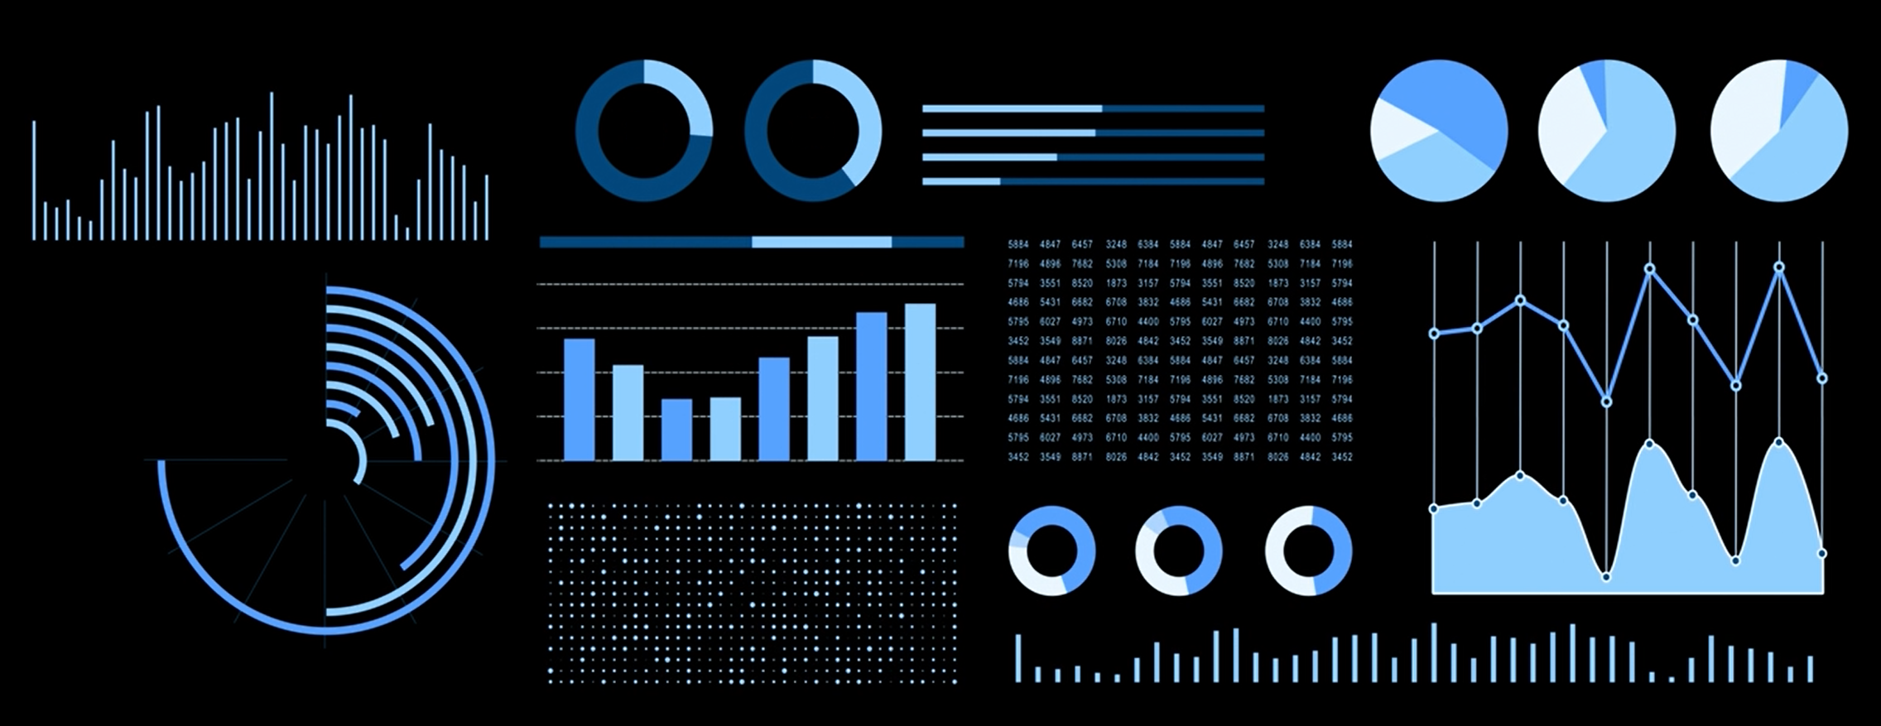
Data Visualization Accessibility for Dashboard Developers

Slide 3
Would you rather?
(A) Analyze data in a spreadsheet
(B) Experience a beautiful data visualization
Notes:
Most people say B. People learn from seeing and experiencing.
A data visualization dashboard provides an experience.
How can a person experience your dashboard if they can't use it because it wasn't designed for a person with a disability?
Whether a dashboard is good and accessible is up to you, the dashboard creator.

Slide 4
Hello 😉
John Cotter
Digital Experience & Accessibility Specialist
NC DIT
Anna Louise McNabb
Public Health Informatician
NC DHHS
Notes:
I asked Anna because…

Slide 5
Digital Accessibility
Who
  Accessibility is usability for a person with a disability.
    blind, low vision, color blind, low mobility, deaf, heard of hearing, cognitive disabilities
What
  Web Content Accessibility Guidelines - WCAG 2.1 Level AA
Why
  It's the right thing to do.
  It's the law – Title 2 of ADA (Americans with Disabilities Act)

Slide 6
How…?
🤔

Slide 7
Dear data viz creators,
Please pay attention to:
Text / Alt Text
Focus Order
Contrast
Use of Color
Instructions
Notes:
There is a lot more to web accessibility, but this presentation is going to focus on these areas relating to data visualization platforms

Slide 8
📖 Text
Labels
Titles
Alt Text
Notes:
Power BI, Tableau, SAS Visual Analytics

Slide 9

Every important object needs text.
If you don't show the text,
then you must add alt text.
Notes:
When you don't have text or alt text on an object, it's like walking up to someone who is wearing a blank name tag. You don't know who they are or why they are important.

Slide 10
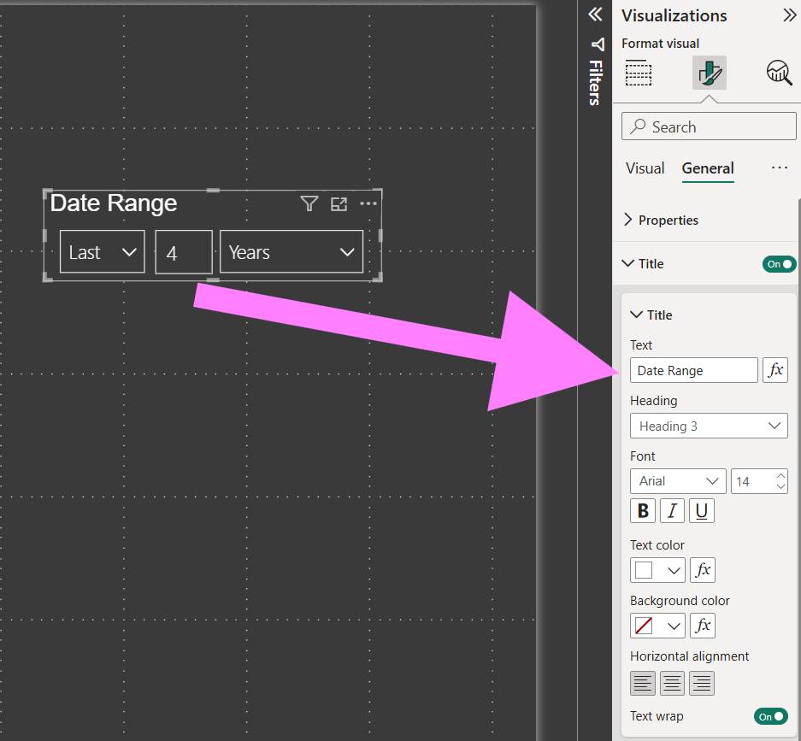
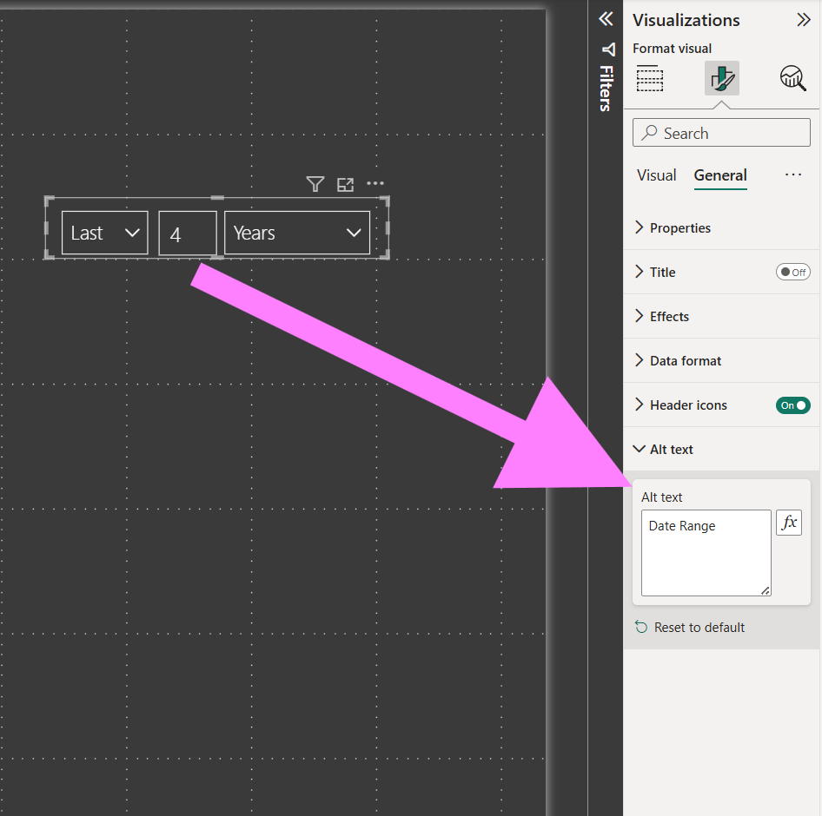
Visible Title Text
Invisible Alt Text
This range slicer has a visible title.
Don't want the text to show?
Okay, but use alt text.
Notes:
(describe images)
If you don't do one of these things, a screen reader will just say "grouping" for every group.
You can also do BOTH: show the title and use the alt text to provide more description. The screen reader reads both.

Slide 11
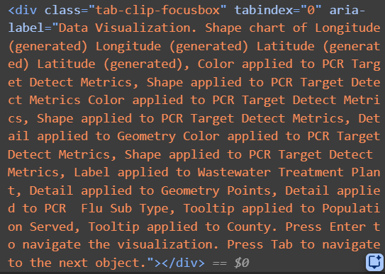
Tableau Alt Text
Tableau auto-generates alt text,
but it's extremely verbose.
Please, please, please, edit the alt text.
Worksheet → Accessibility → Alt Text
Do this for every worksheet !!!

Slide 12
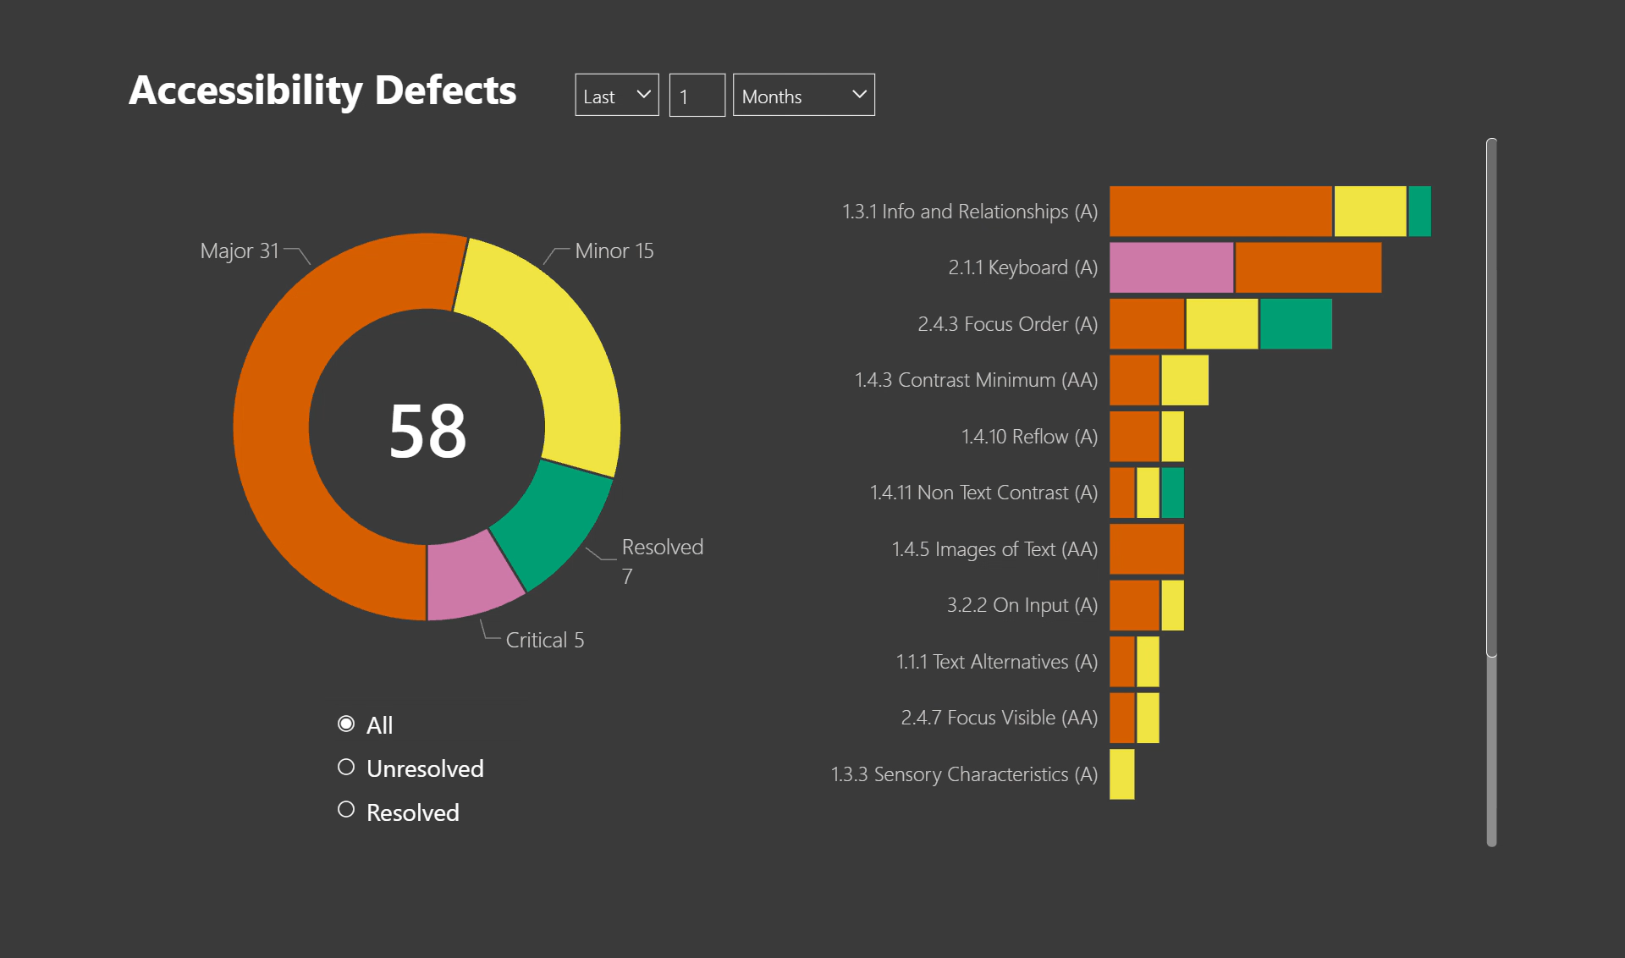
Video: Not Accessible
What a screen reader says when you don't set titles and alt text…
Each group just says "grouping"
Notes:
Without alt text on groups, a screen reader user must navigate into each group to figure out what it is.

Slide 13
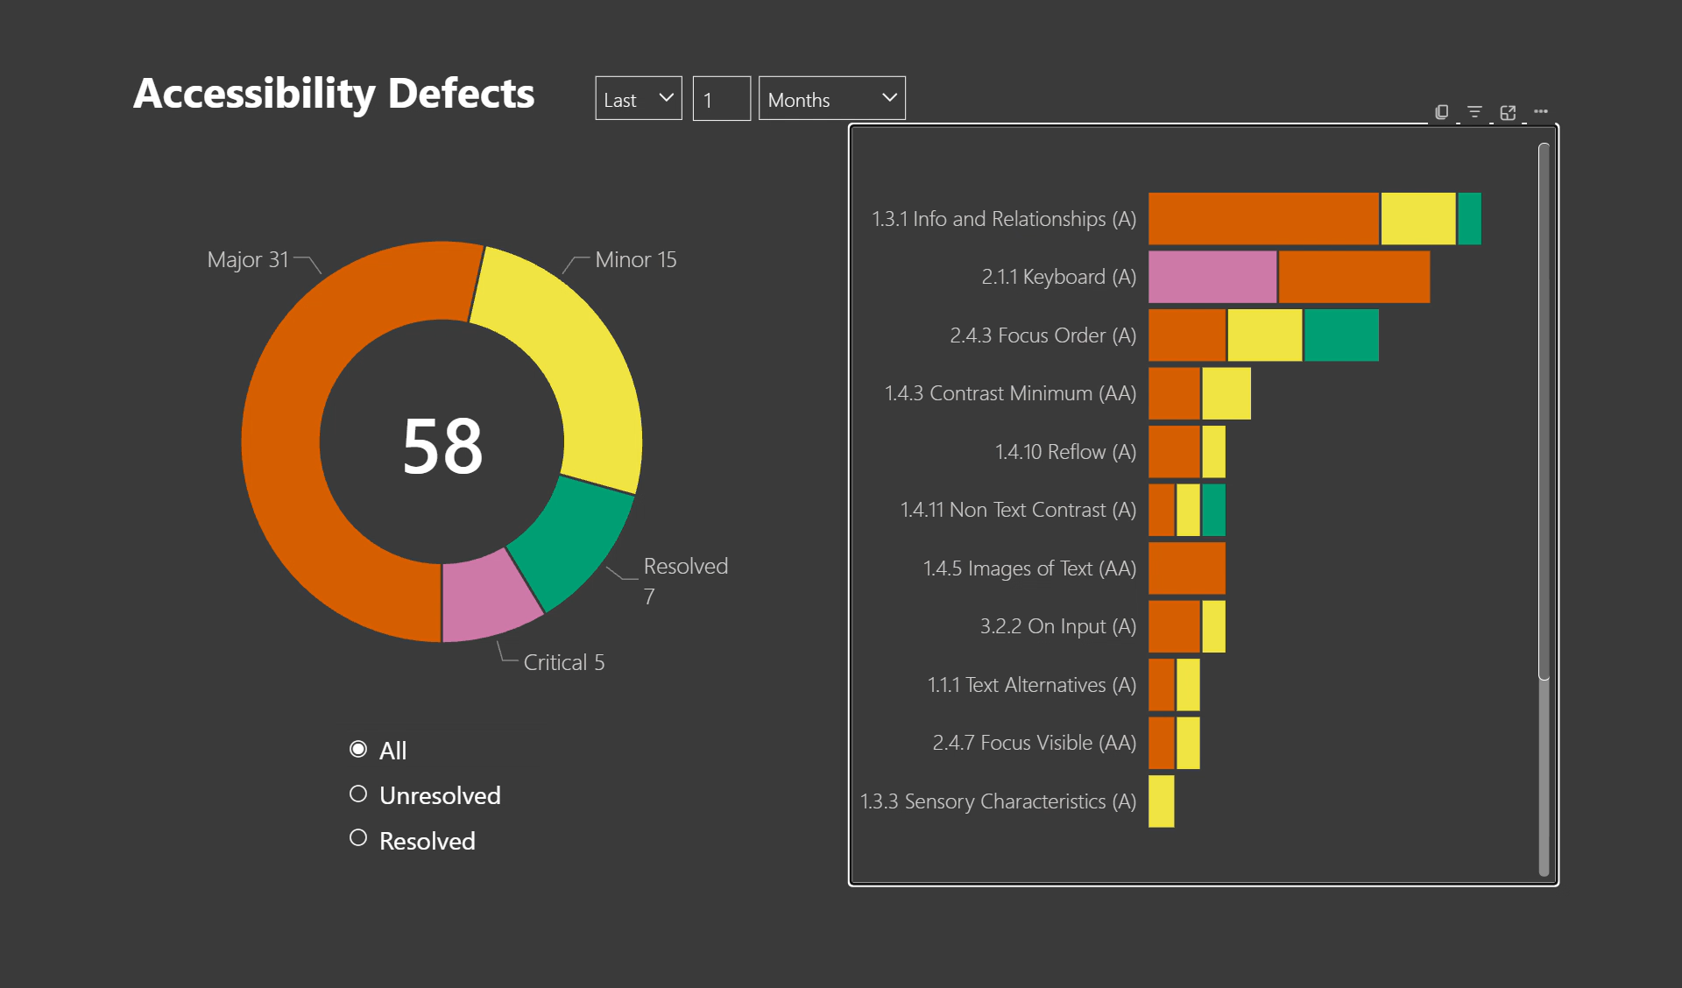
Video: Accessible
When each group has
alt text, a screen reader user understands the layout.
Each group has a unique name.

Slide 14
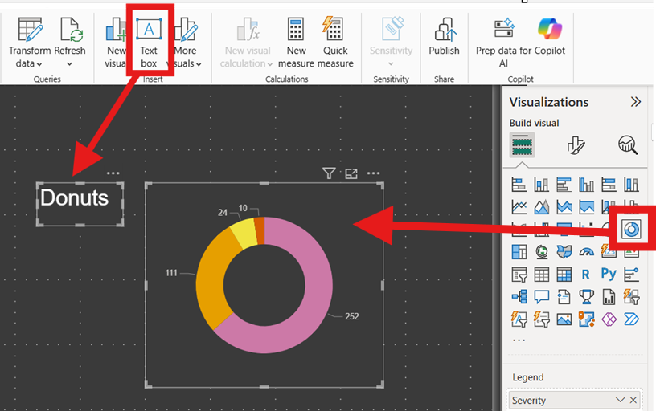
Don't use a text box to label individual objects.
These are two separate things.
A screen reader user won't know this chart is associated to the text box.
Instead, use the alt text or title on the chart.
Notes:
Please don't do this.

Slide 15
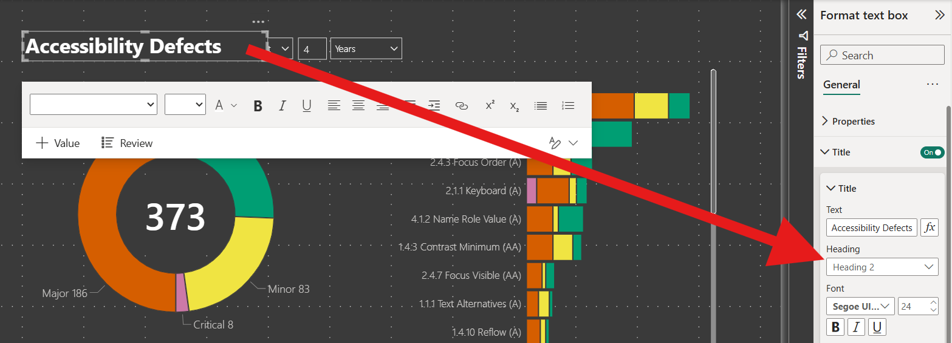
Use text box for headings, summaries, and instructions.
Notes:
So what DO you use text box for?

Slide 16
⬇️ Focus Order
Keyboard Navigation
Tab order

Slide 17

Not everyone uses a mouse
A person might use a keyboard to navigate because of a disability.
Notes:
Our data visualization dashboards need to work for keyboard users.

Slide 18
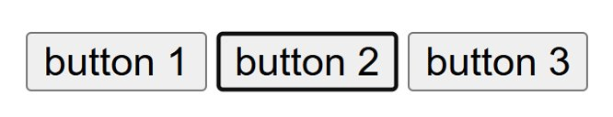
Visual Indication of Focus

Slide 19

Tab Order
Don't make keyboard users navigate a maze.
Focus should move in an order that makes sense.
WCAG SC 2.4.3
Notes:
https://app.powerbigov.us/groups/me/reports/38518c97-658f-4323-b1f3-3866cb653010/3ce816ca760663c51bc5?ctid=7a7681dc-b9d0-449a-85c3-ecc26cd7ed19

Slide 20
How to Control Tab Order
Power BI
View → Selection → Tab Order (not the Layer order)
"Have tab order match visual order" button
Reorder objects in the selection pane.
Hide decorative things that shouldn't be in tab order
(eyeball icon)
How to fix tab order (Power BI)
Tableau
(As of Feb 2026) Edit the XML:
How to fix tab order (Tableau)

Slide 21
Keyboard Navigation
The Platform's keyboard navigation may not be "intuitive" for keyboard users.
Keyboard Navigation Documentation:
Power BI
Power BI Keyboard Accessibility
Tableau
Tableau Keyboard Accessibility

Slide 22
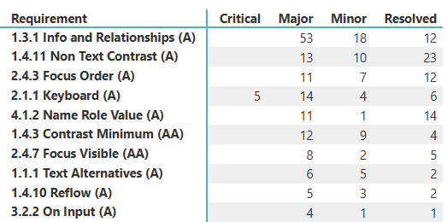
Show Table View
A user may prefer a table
instead of the visualization.
Power BI
  Functionality is automatic:
  Select visualization
  Alt + Shift + F11 to show as a table
Tableau
  You need to turn it on:
  Worksheet → enable "Show View Data"
  Now users can:
  Select visualization
  Alt to activate menu bar
  Worksheet → "View Data" to show as a table
Notes:
Because the visualizations can be tricky to understand and navigate with a keyboard or screen reader, a user may prefer to read the data as a table instead of a visualization.

Slide 23
☯️ Contrast
Text Contrast
Graphical Object Contrast
User Interface Contrast

Slide 24
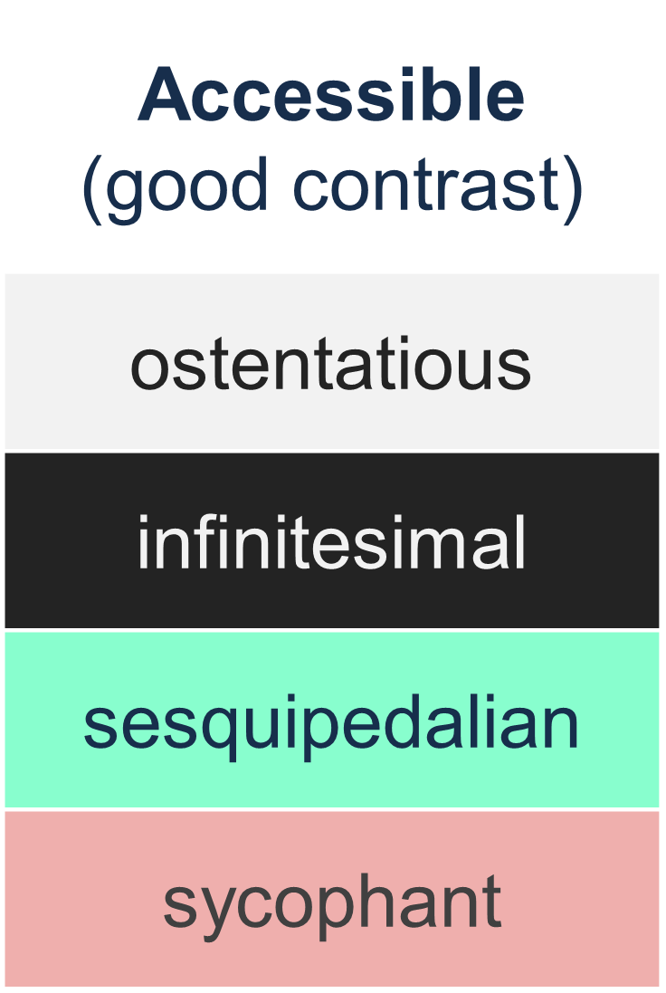
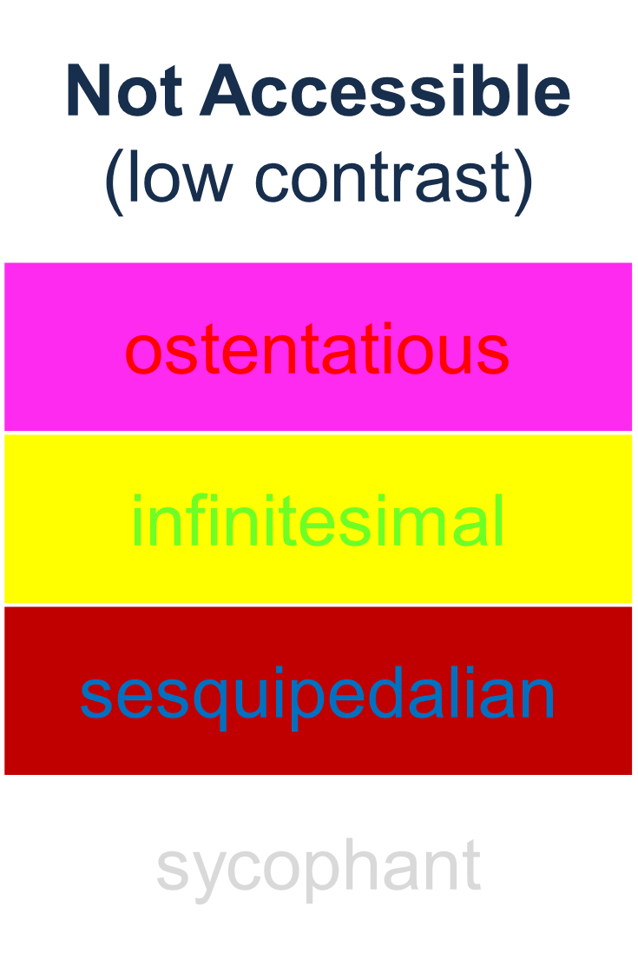
Text Contrast
Text must have a contrast ratio of at least 4.5:1 WCAG SC 1.4.3

Slide 25
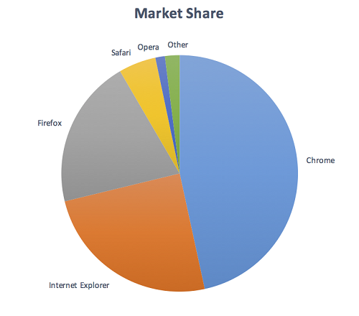
Non-Text Contrast
Graphical Objects must have a contrast ratio
of at least 3:1 with adjacent colors. WCAG SC 1.4.11
The green and blue slices touch, so their contrast must be 3:1 or greater.
#8FB560 green against #779ED8 blue measures 1.2:1 so this combo fails.
Need to measure all touching colors.

Slide 26
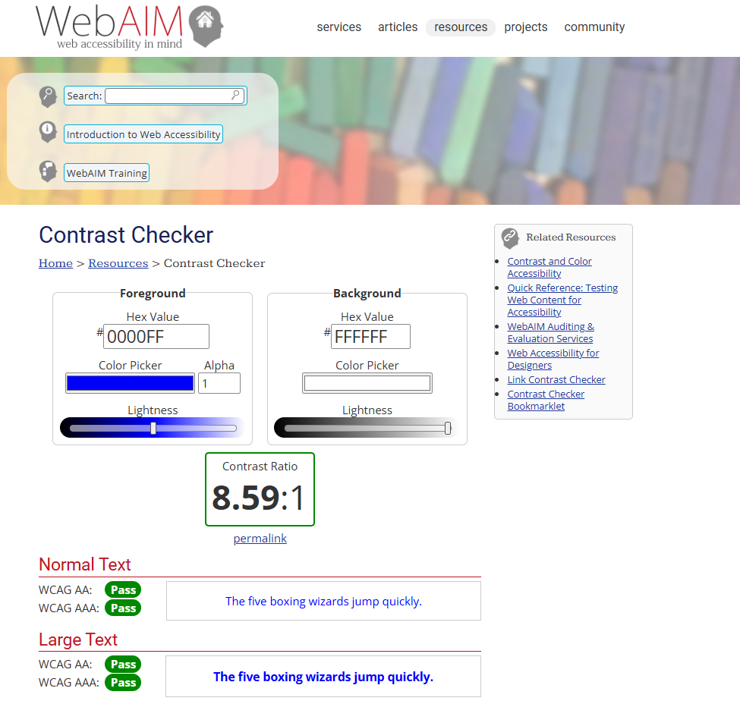
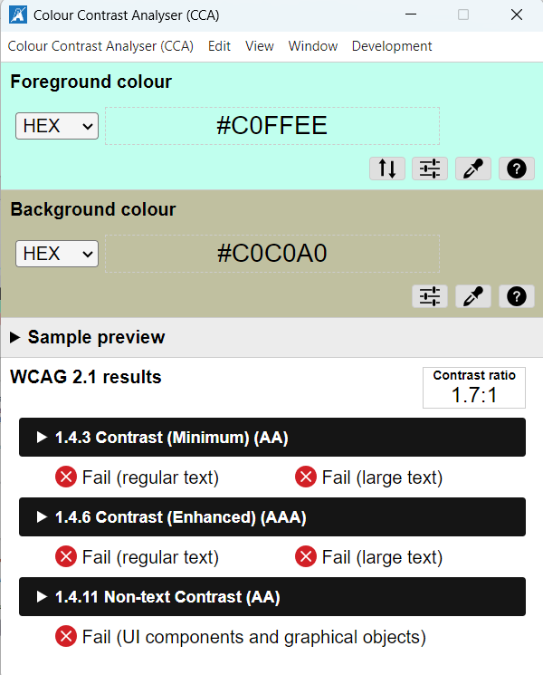
Measure Contrast Ratio
Web Aim Contrast Checker
Colour Contrast Analyser

Slide 27
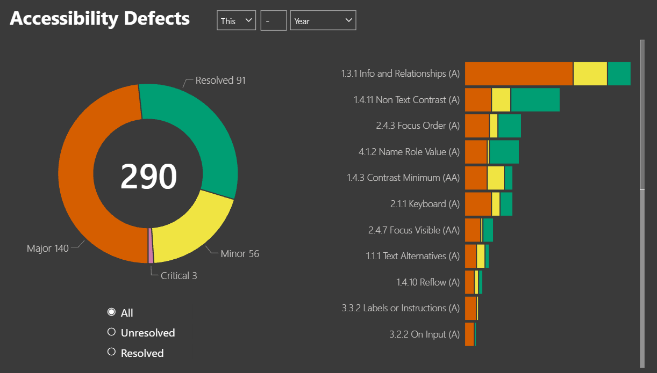
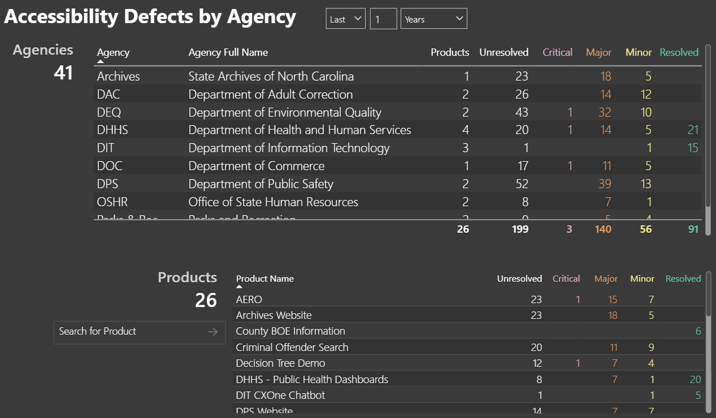
Dark Background Theme
Want more color variety? Try a dark background theme.

Slide 28
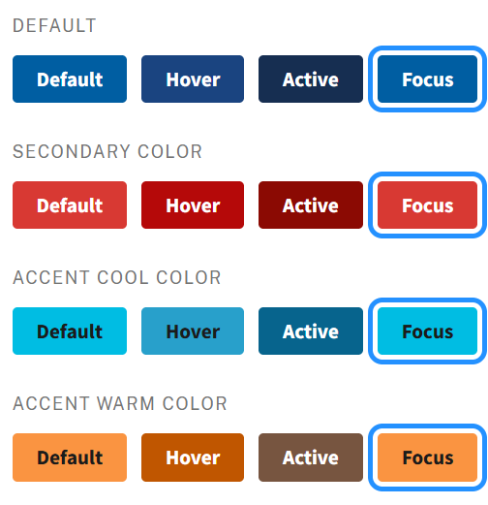
State Changes
Test the contrast when colors change on hover, pressed, select, and focus.
USWDS Button Components

Slide 29
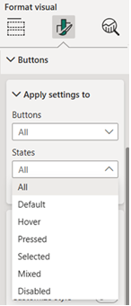
Styling States
Power BI
For a slicer:
Visual → Buttons → Apply settings to → States
Tableau
No native support for customizing style of button states 😱

Slide 30
🎨 Use of Color
Colorblind Palettes
Color as Meaning

Slide 31
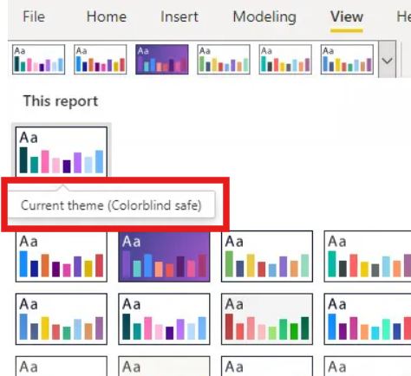
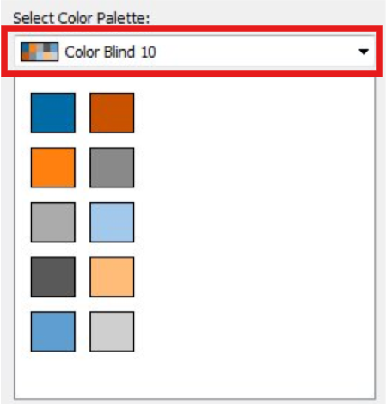
Use a Colorblind Palette
Power BI
Tableau

Slide 32
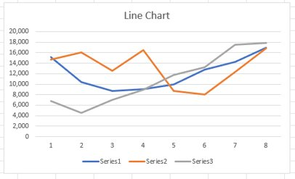
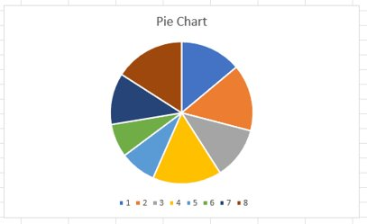
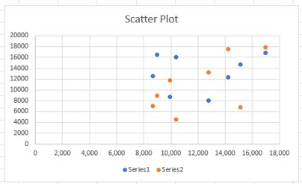
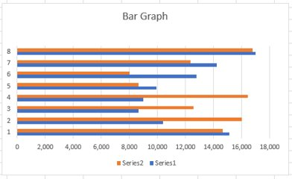
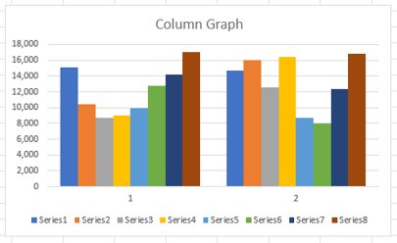
Not Accessible: Need Color Vision

Slide 33
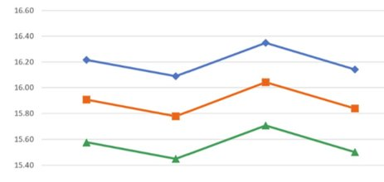
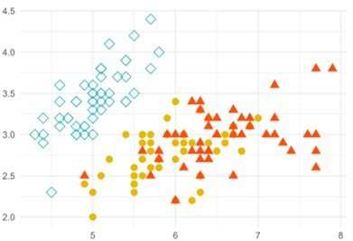
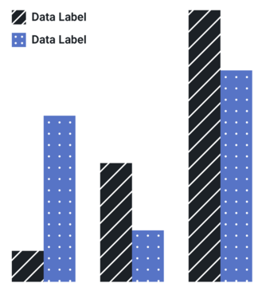
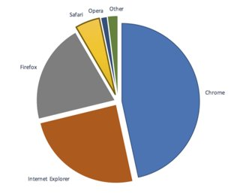
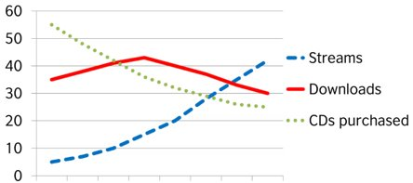
Accessible: Don't Need Color Vision
Notes:
Use markers

Slide 34
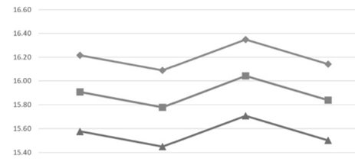
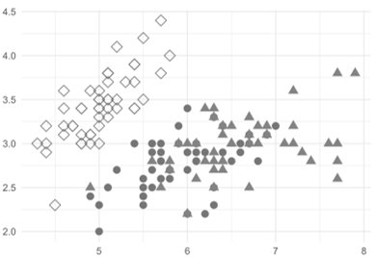
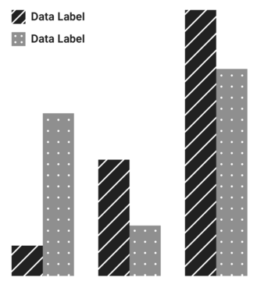
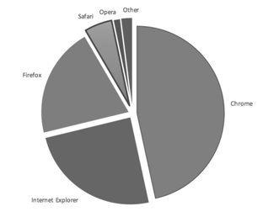
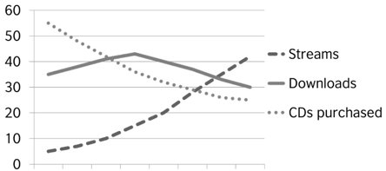
Test it in Grayscale

Slide 35
💬 Instructions
Non-sensory Instructions
User Guides
Simplicity

Slide 36

Sensory Characteristics
In your instructions…
Describe controls by name, not by how they look.
Use words like "activate", "select", or "press".
"Click" is an instruction for mouse users.
Use plain language:
Clear, concise, and organized instructions.

Slide 37

User Guides
Be helpful.
Give users instructions on how to use
non-intuitive interfaces.
Link to the platform's own accessibility documentation for end users.
Give a contact to report accessibility issues.

Slide 38
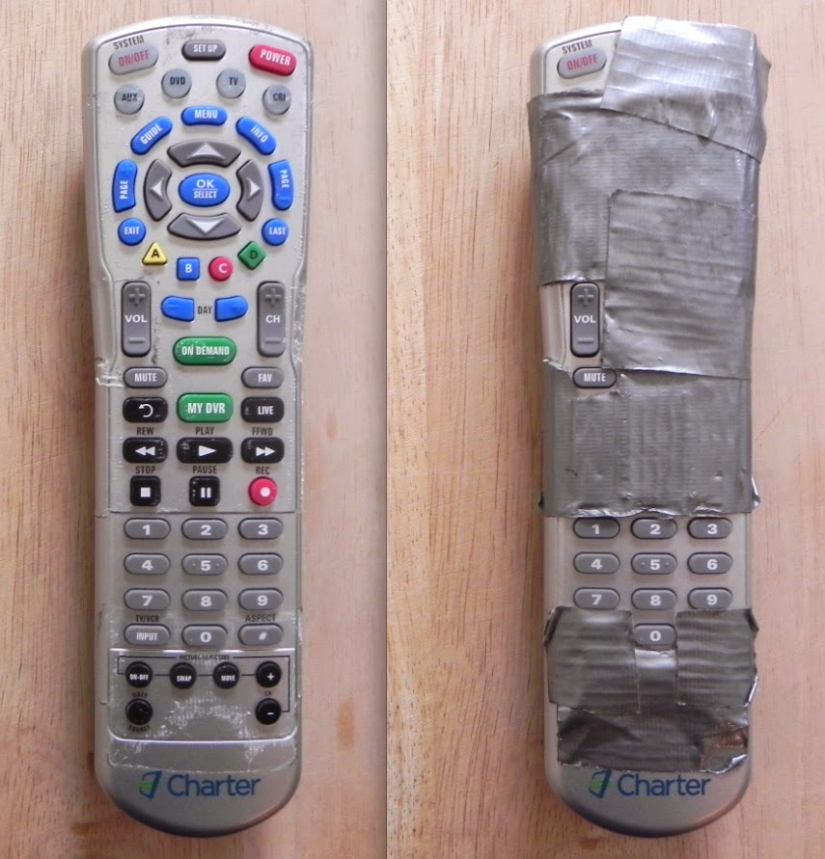
No Fancy Features
Decide what matters. Let go of the rest.
Turn advanced features off:
Power BI
Visual header icons
Drill down / drill through
Tableau
View Toolbar
"Use as Filter"
Complex Tooltips
Notes:
More stuff = more work
Cool for data analysts, overkill for the public.
Extra features increase cognitive load and must be tested for accessibility.

Slide 39

It may be the platform's fault, but it's your responsibility.
Notes:
Yes, I used comic sans

Slide 40
Issues Caused by Platform
What can you do?
  Remove it
  Swap it
  Read the documentation
  Contact the platform
  More Guidance:
  Dealing with a Third Party Accessibility Issue

Slide 41
Resources
General
NCDIT Web Content Accessibility
https://it.nc.gov/digital-accessibility/web-content-accessibility
NCDIT Resources
https://it.nc.gov/digital-accessibility/digital-accessibility-resources
Digital Commons: Power BI Tips
https://digitalcommons.nc.gov/accessibility/power-bi-reports
Platform Documentation
Power BI Accessibility
https://learn.microsoft.com/en-us/power-bi/create-reports/desktop-accessibility-creating-reports
Tableau Accessibility
https://help.tableau.com/current/tableau/en-us/accessibility.htm
SAS Visual Analytics Accessibility
https://support.sas.com/documentation/prod-p/va/7.4/en/HTML/vaa11y.htm
Tools
Your Keyboard
A Screen Reader
https://it.nc.gov/digital-accessibility/digital-accessibility-resources#screenreaders
Color Contrast Analyzer
https://www.tpgi.com/color-contrast-checker/
Web Aim Contrast Checker
https://webaim.org/resources/contrastchecker/

Slide 42

Digital Accessibility Support
Get consultations, testing, training for North Carolina:
https://ncgov.servicenowservices.com/sp_dit?id=sc_cat_item&sys_id=9947179edb076ad067bdf055f39619fc
Thank you for considering the accessibility of your data visualizations.
John Cotter
Digital Experience & Accessibility Specialist

